Slide 1
Open SAR Toolkit - Demo Lecture 1a
Creating a single-polarized, radiometrically terrain corrected scene
with the Open SAR toolkit

Slide 2
You will learn
How to download a Sentinel-1 scene using an Open SAR Toolkit inventory shapefile
How to process a single Sentinel-1 GRD product to a radiometrically terrain corrected product
Understand the Layover/Shadow masking

Slide 3
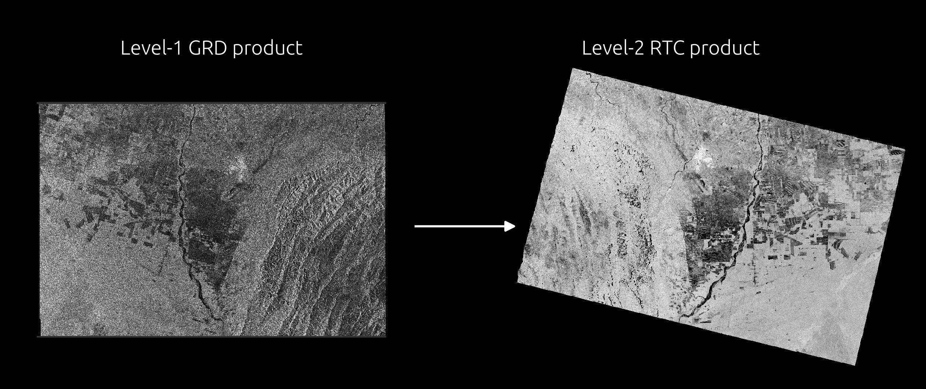
From Level-1 GRD to Level-2 RTC product

Slide 4
From Level-1 GRD to Level-2 RTC product
GRD = Ground Range Detected
first preprocessing steps done by ESA Satellite Ground Segment
contains only Intensity information
no Calibration, Speckle filter, Geocoding etc
RTC = Radiometrically Terrain Corrected
Analysis ready data for land applications
Includes slope correction

Slide 5
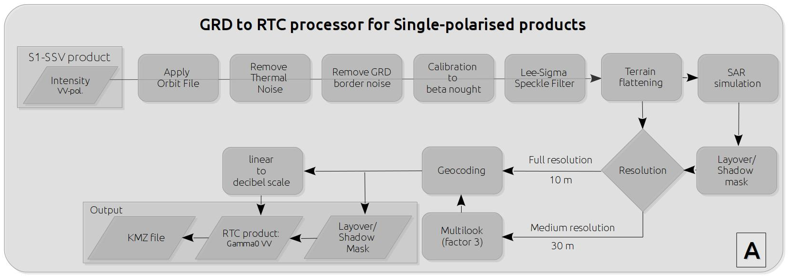
From Level-1 GRD to Level-2 RTC product
Processing steps applied by the OST S1 GRD to RTC processor
Fully automatic
Only choice is output resolution

Slide 6
Resolution
10 m versus 30 m resolution

Slide 7
Let's get started
Open your favorite browser
Go to: https://sepal.io/

Slide 8

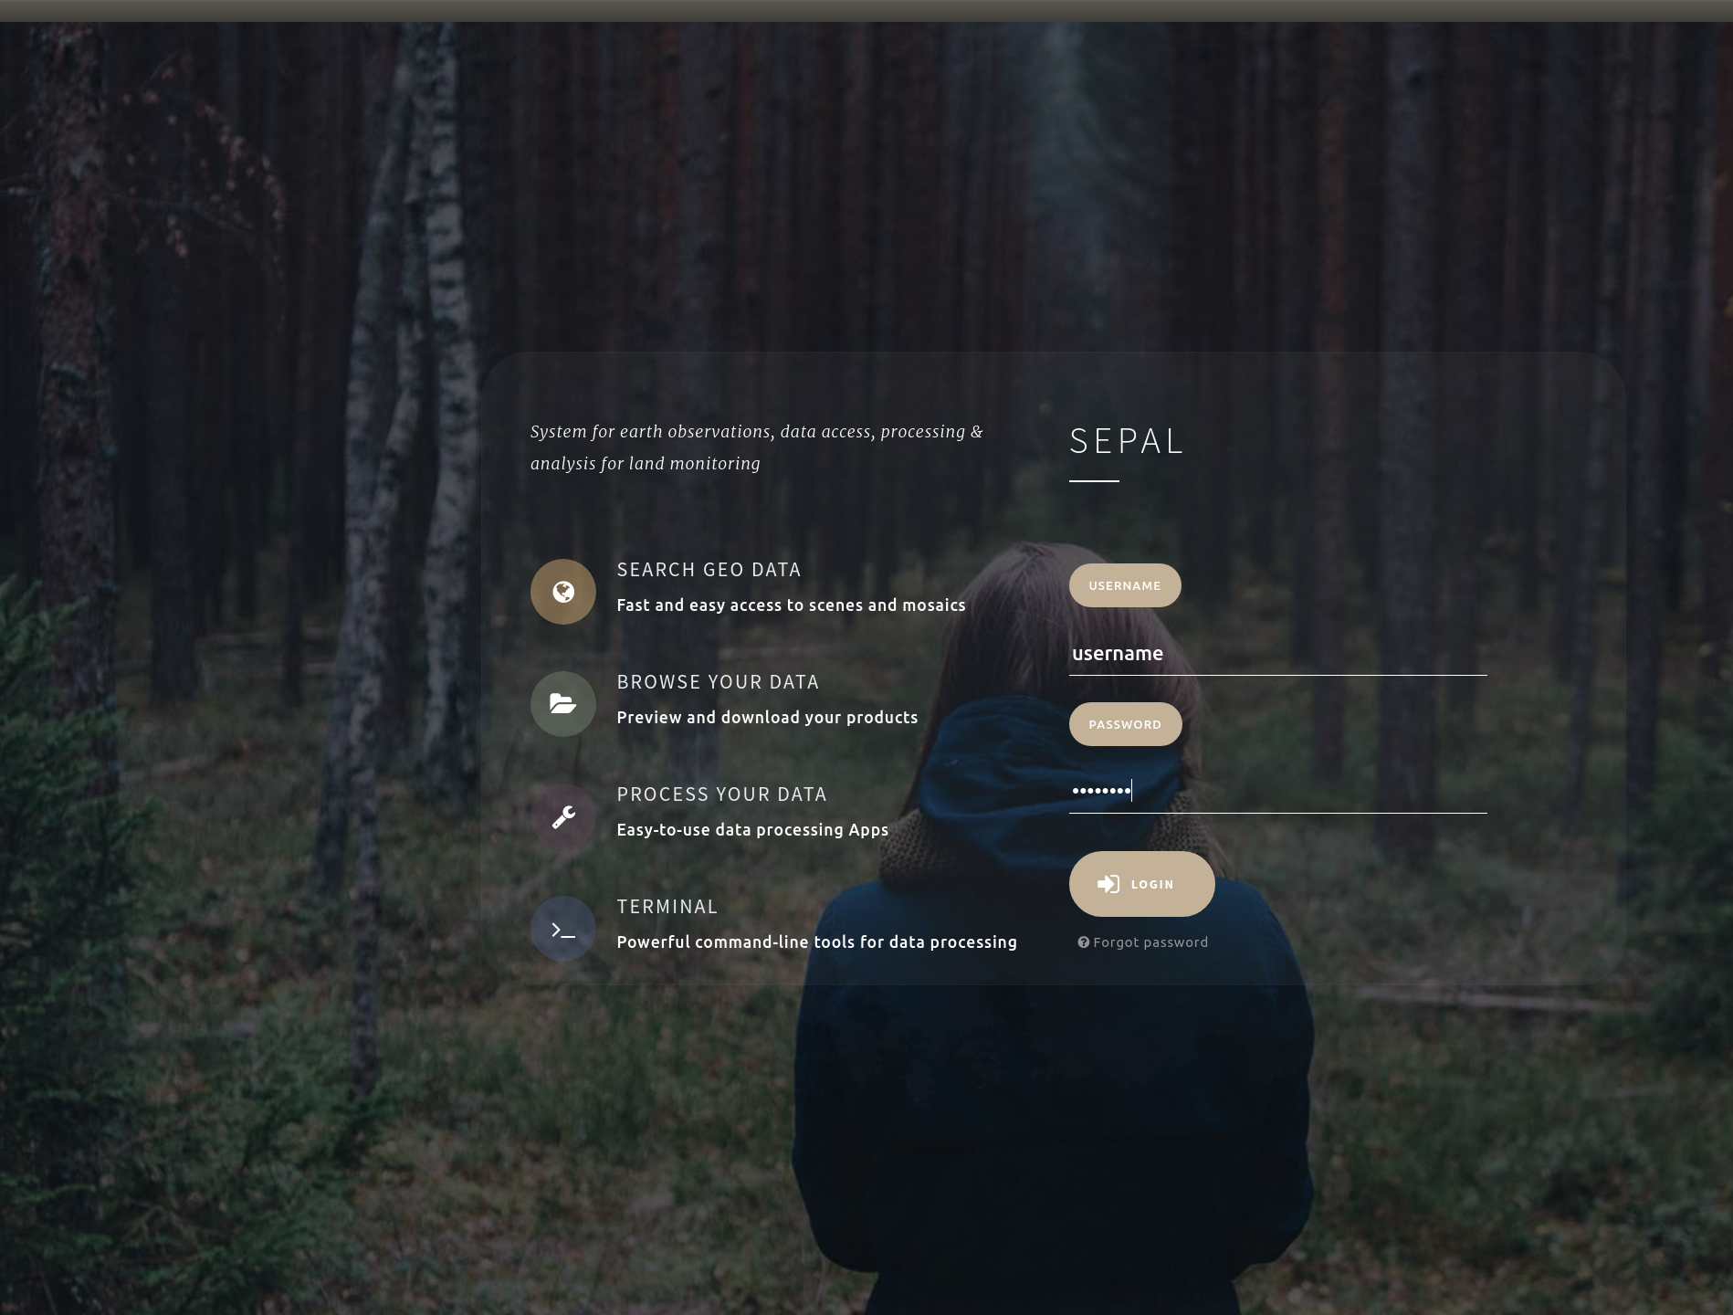
Login
Login with your username and password

Slide 9
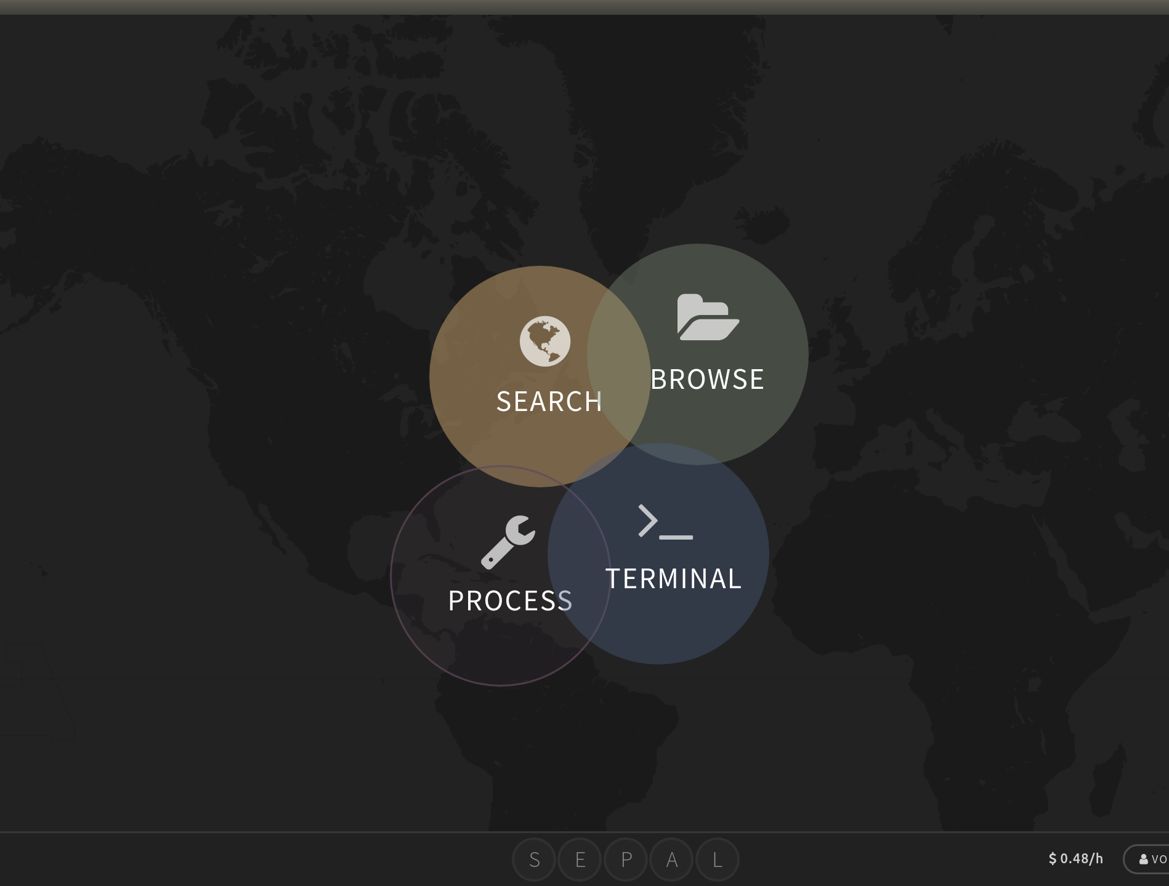
Selection I
Select the Process Module

Slide 10
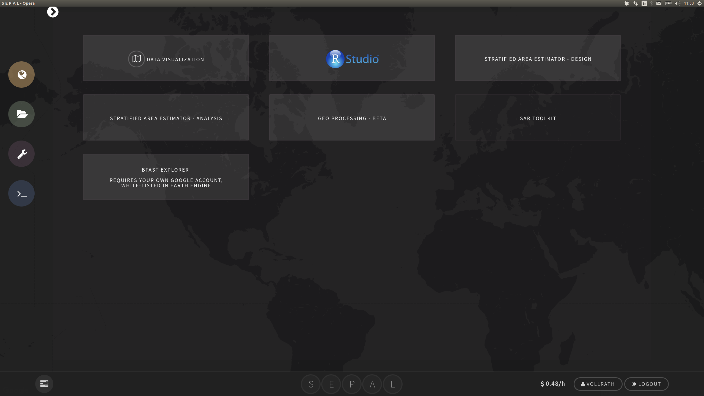
Selection II
Select the SAR TOOLKIT

Slide 11
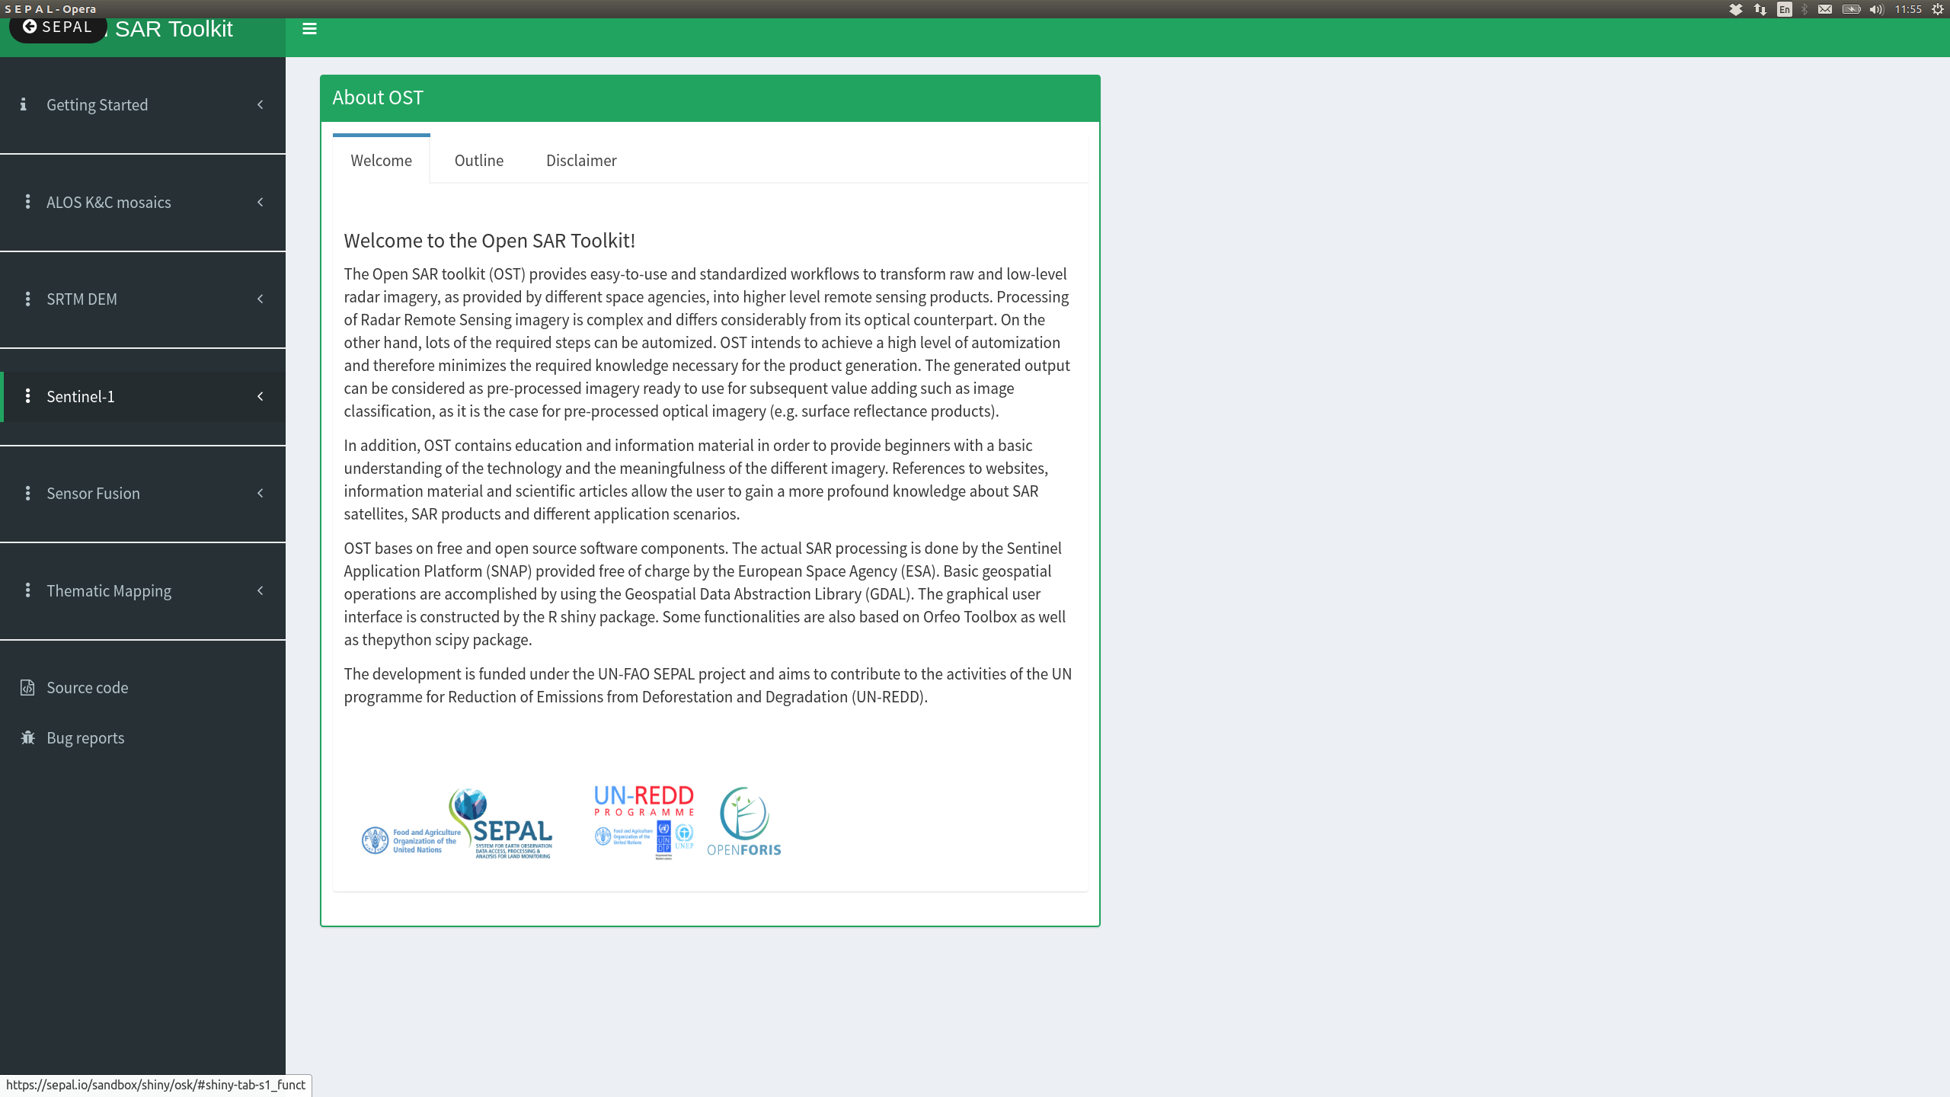
OPEN Sar TOOLKIT
Your screen should look like this
Processing menu on the left
Click on Sentinel-1

Slide 12
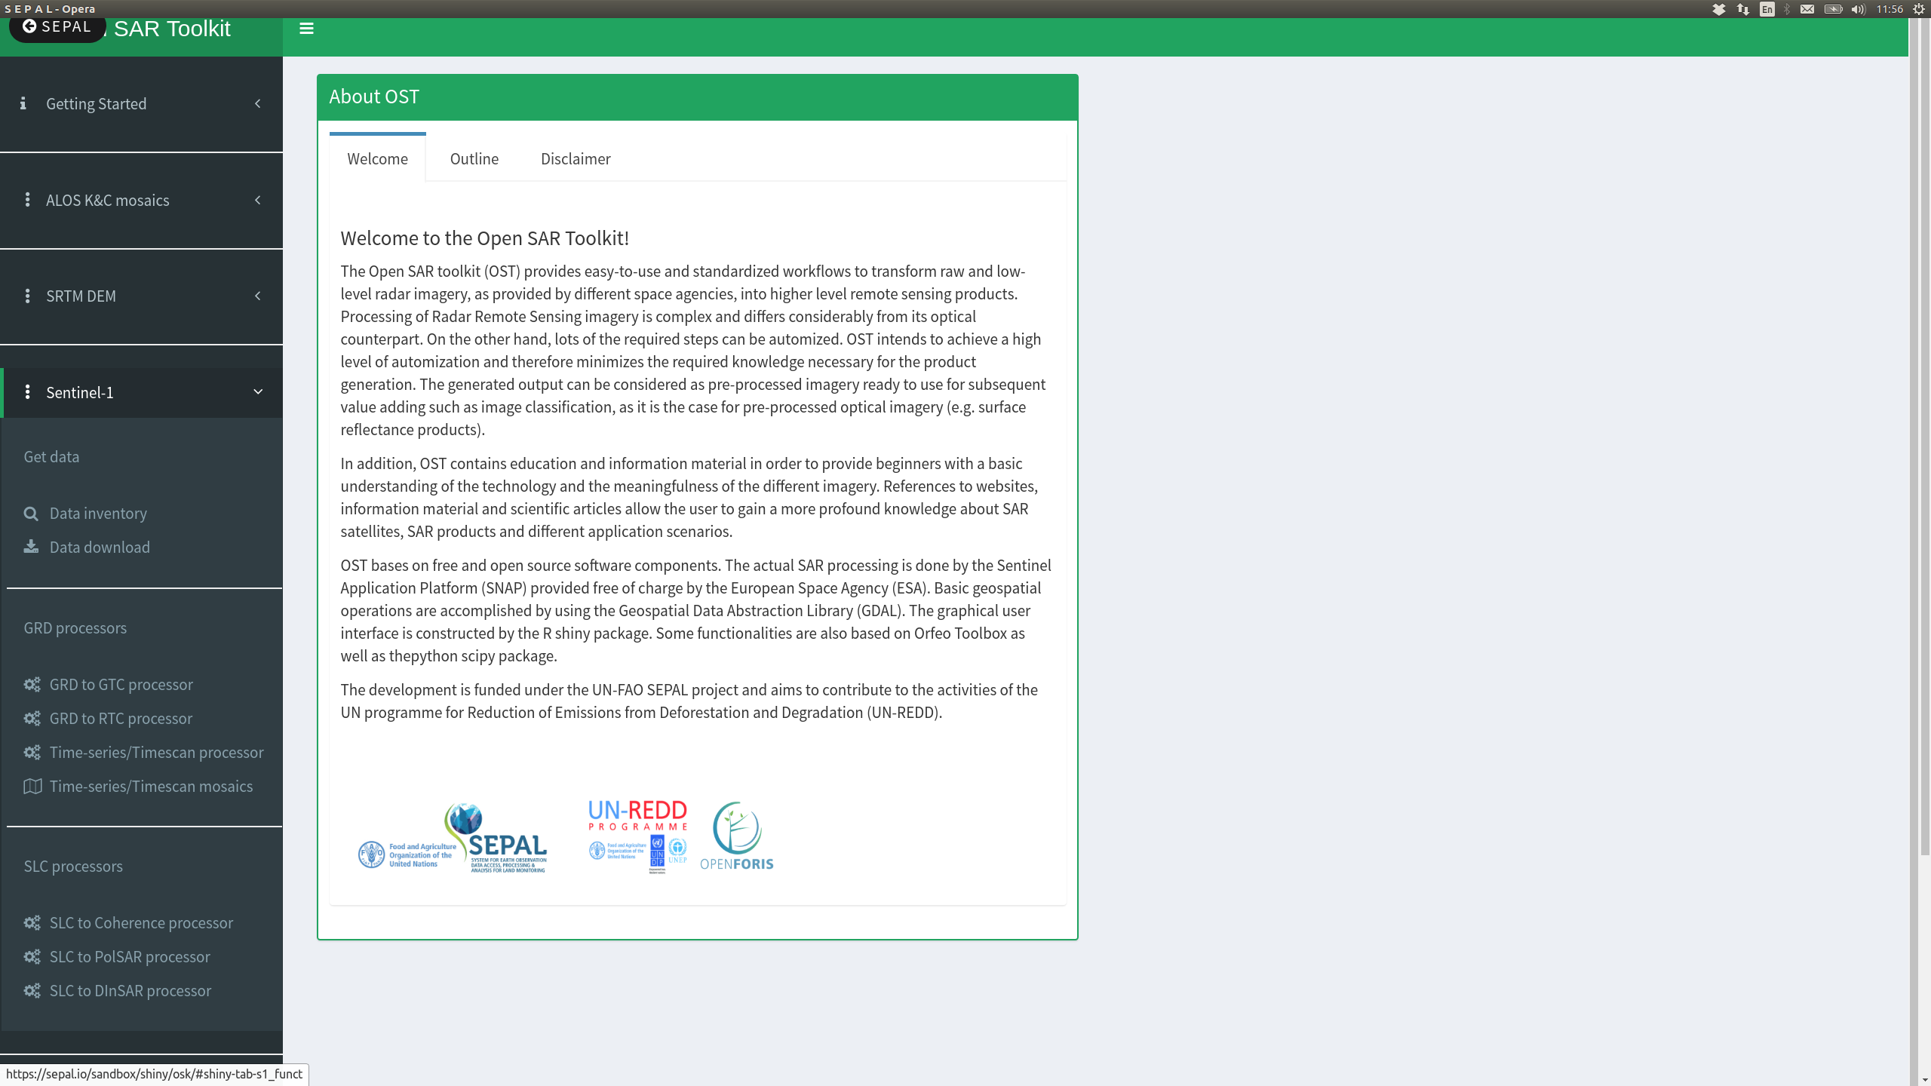
Sentinel-1 menu
Divided by
1 Get data
2 GRD processors
3 SLC processors

Slide 13
Get Sentinel-1 data
General workflow
1a Data Inventory
Creation of a OST inventory shapefile
Refinement of OST inventory shapefile using a GIS (recommended)
1b Data Download
Based on OST inventory shapefile

Slide 14
Data inventory
Search parameters for data pre- selection
Creates an OST Inventory Shapefile
For now we'll skip the inventory and download the following OST inventory shapefile containing one scene

Slide 15
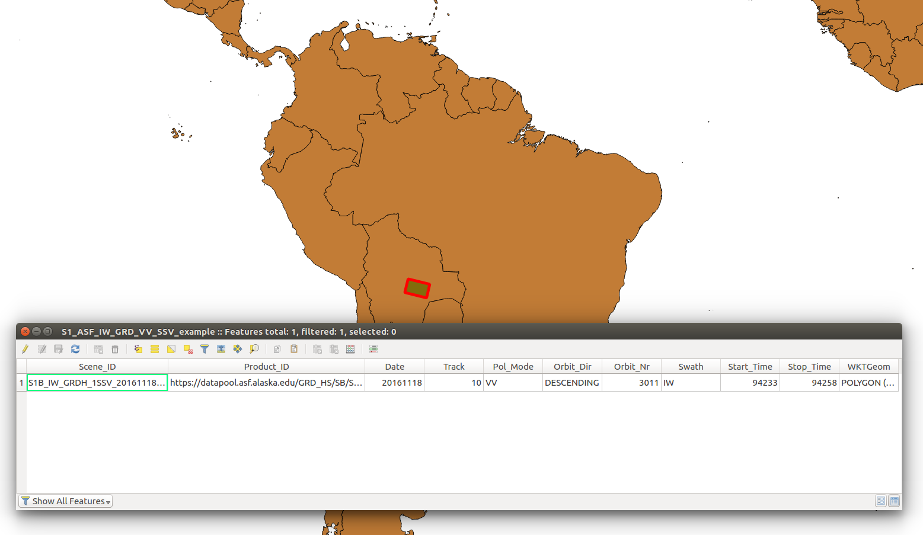
OST inventory shapefile
Contains the footprints and metadata of the scenes found by the data inventory
Product_id refers to the download link
Example of 1 scene over Santa cruz della Sierra, Bolivia
Link: https://www.dropbox.com/s/iv3jynbpjo2ps6m/s1_ssv_example.zip?dl=0

Slide 16
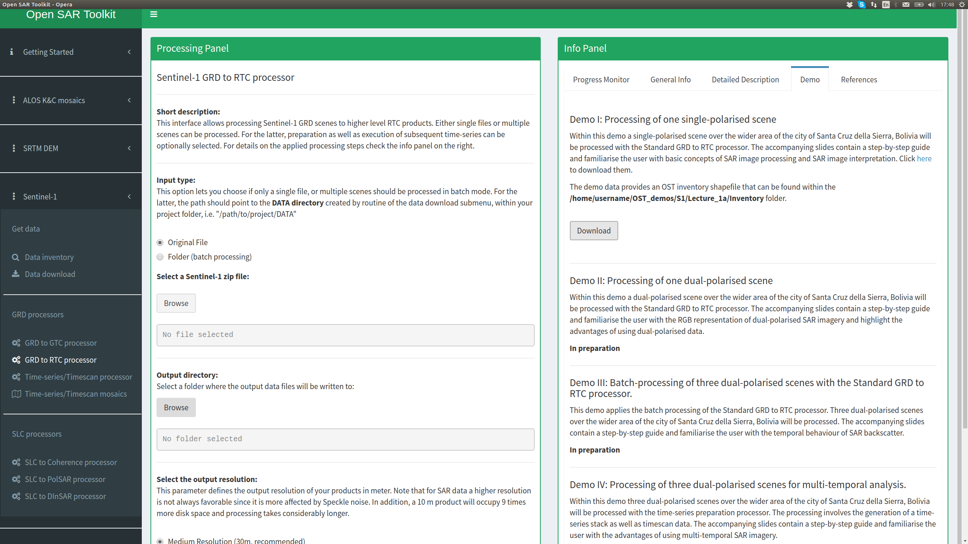
Get Demo data
2
1 Go to GRD to RTC processor
2 In the Info panel switch to the Demo tab
3 Get the files by clicking download
3
1

Slide 17
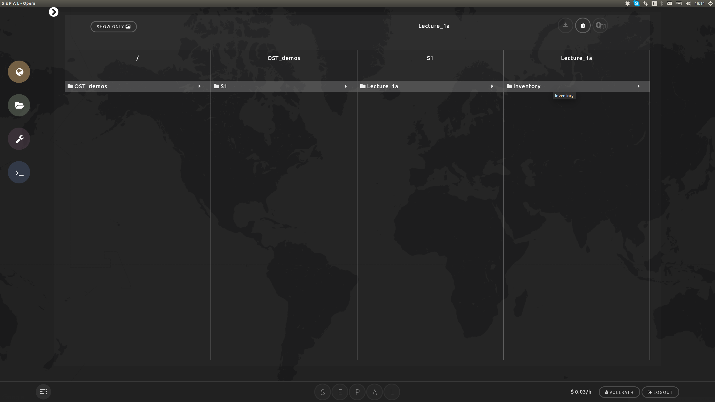
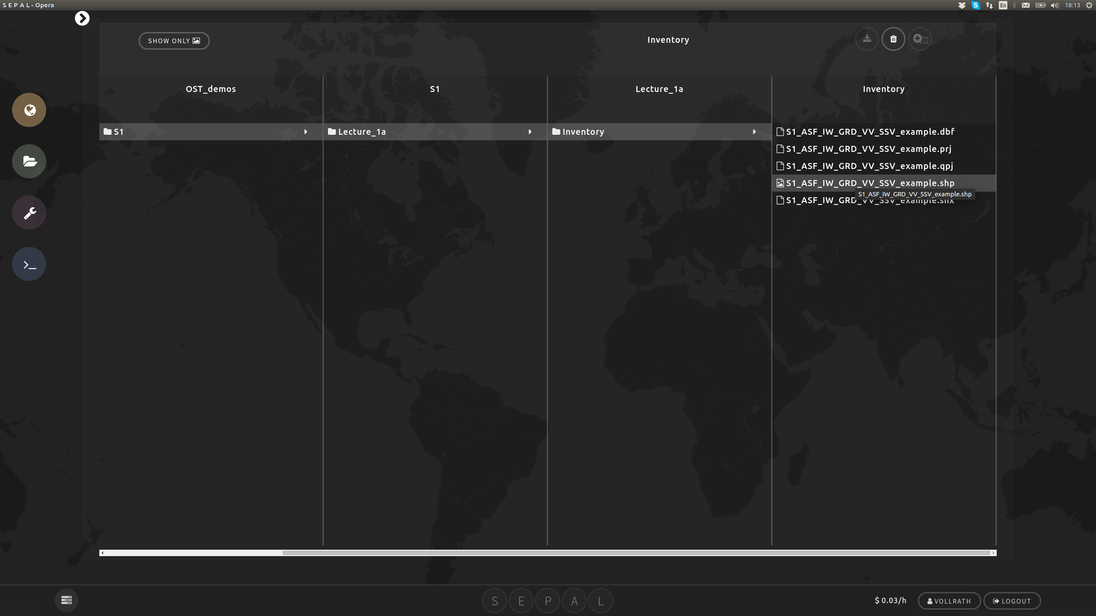
Demo File location
OST inventory file under:
/home/username/OST_demos/S1/Lecture_1a/Inventory

Slide 18
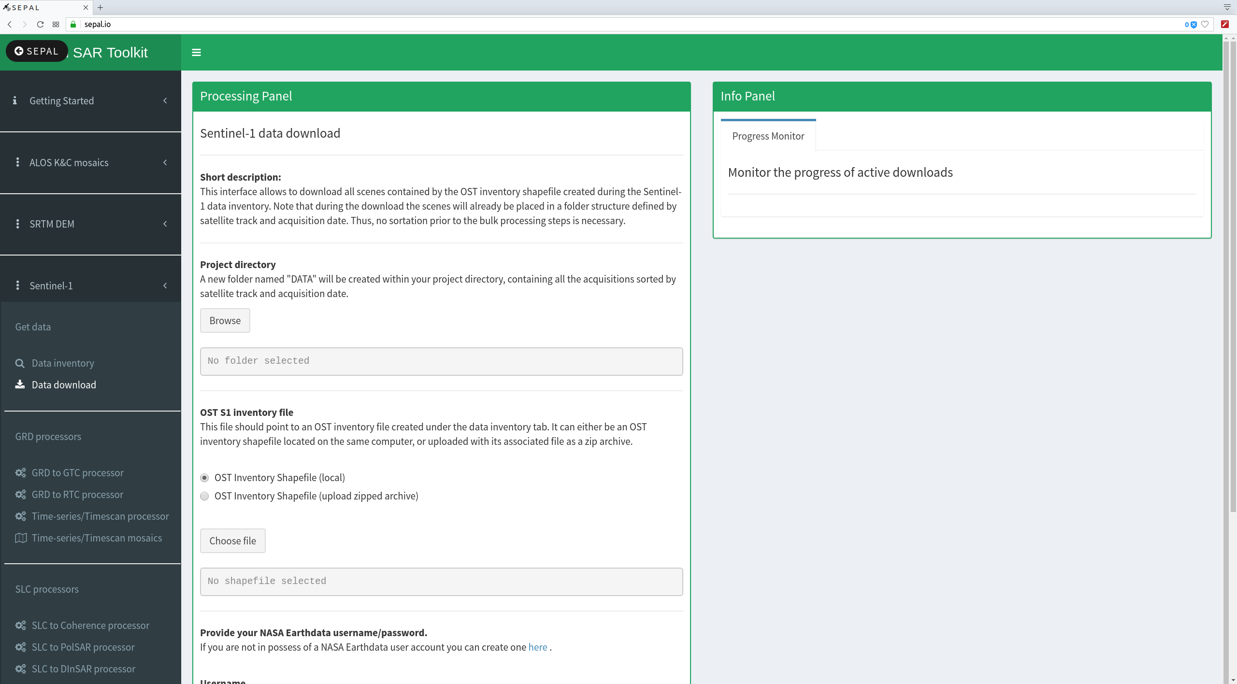
Data download
1b Sentinel-1 Data Download
Download based on OST inventory shapefile
Needs NASA Earthdata credentials + allowance of (my applications):
Alaska Satellite Facility Data Access
Best way:
Go to: https://vertex.daac.asf.alaska.edu/
Register for an Account there OR
Use YOUR existent NASA earthdata account and allow for access to ASF data centre

Slide 19
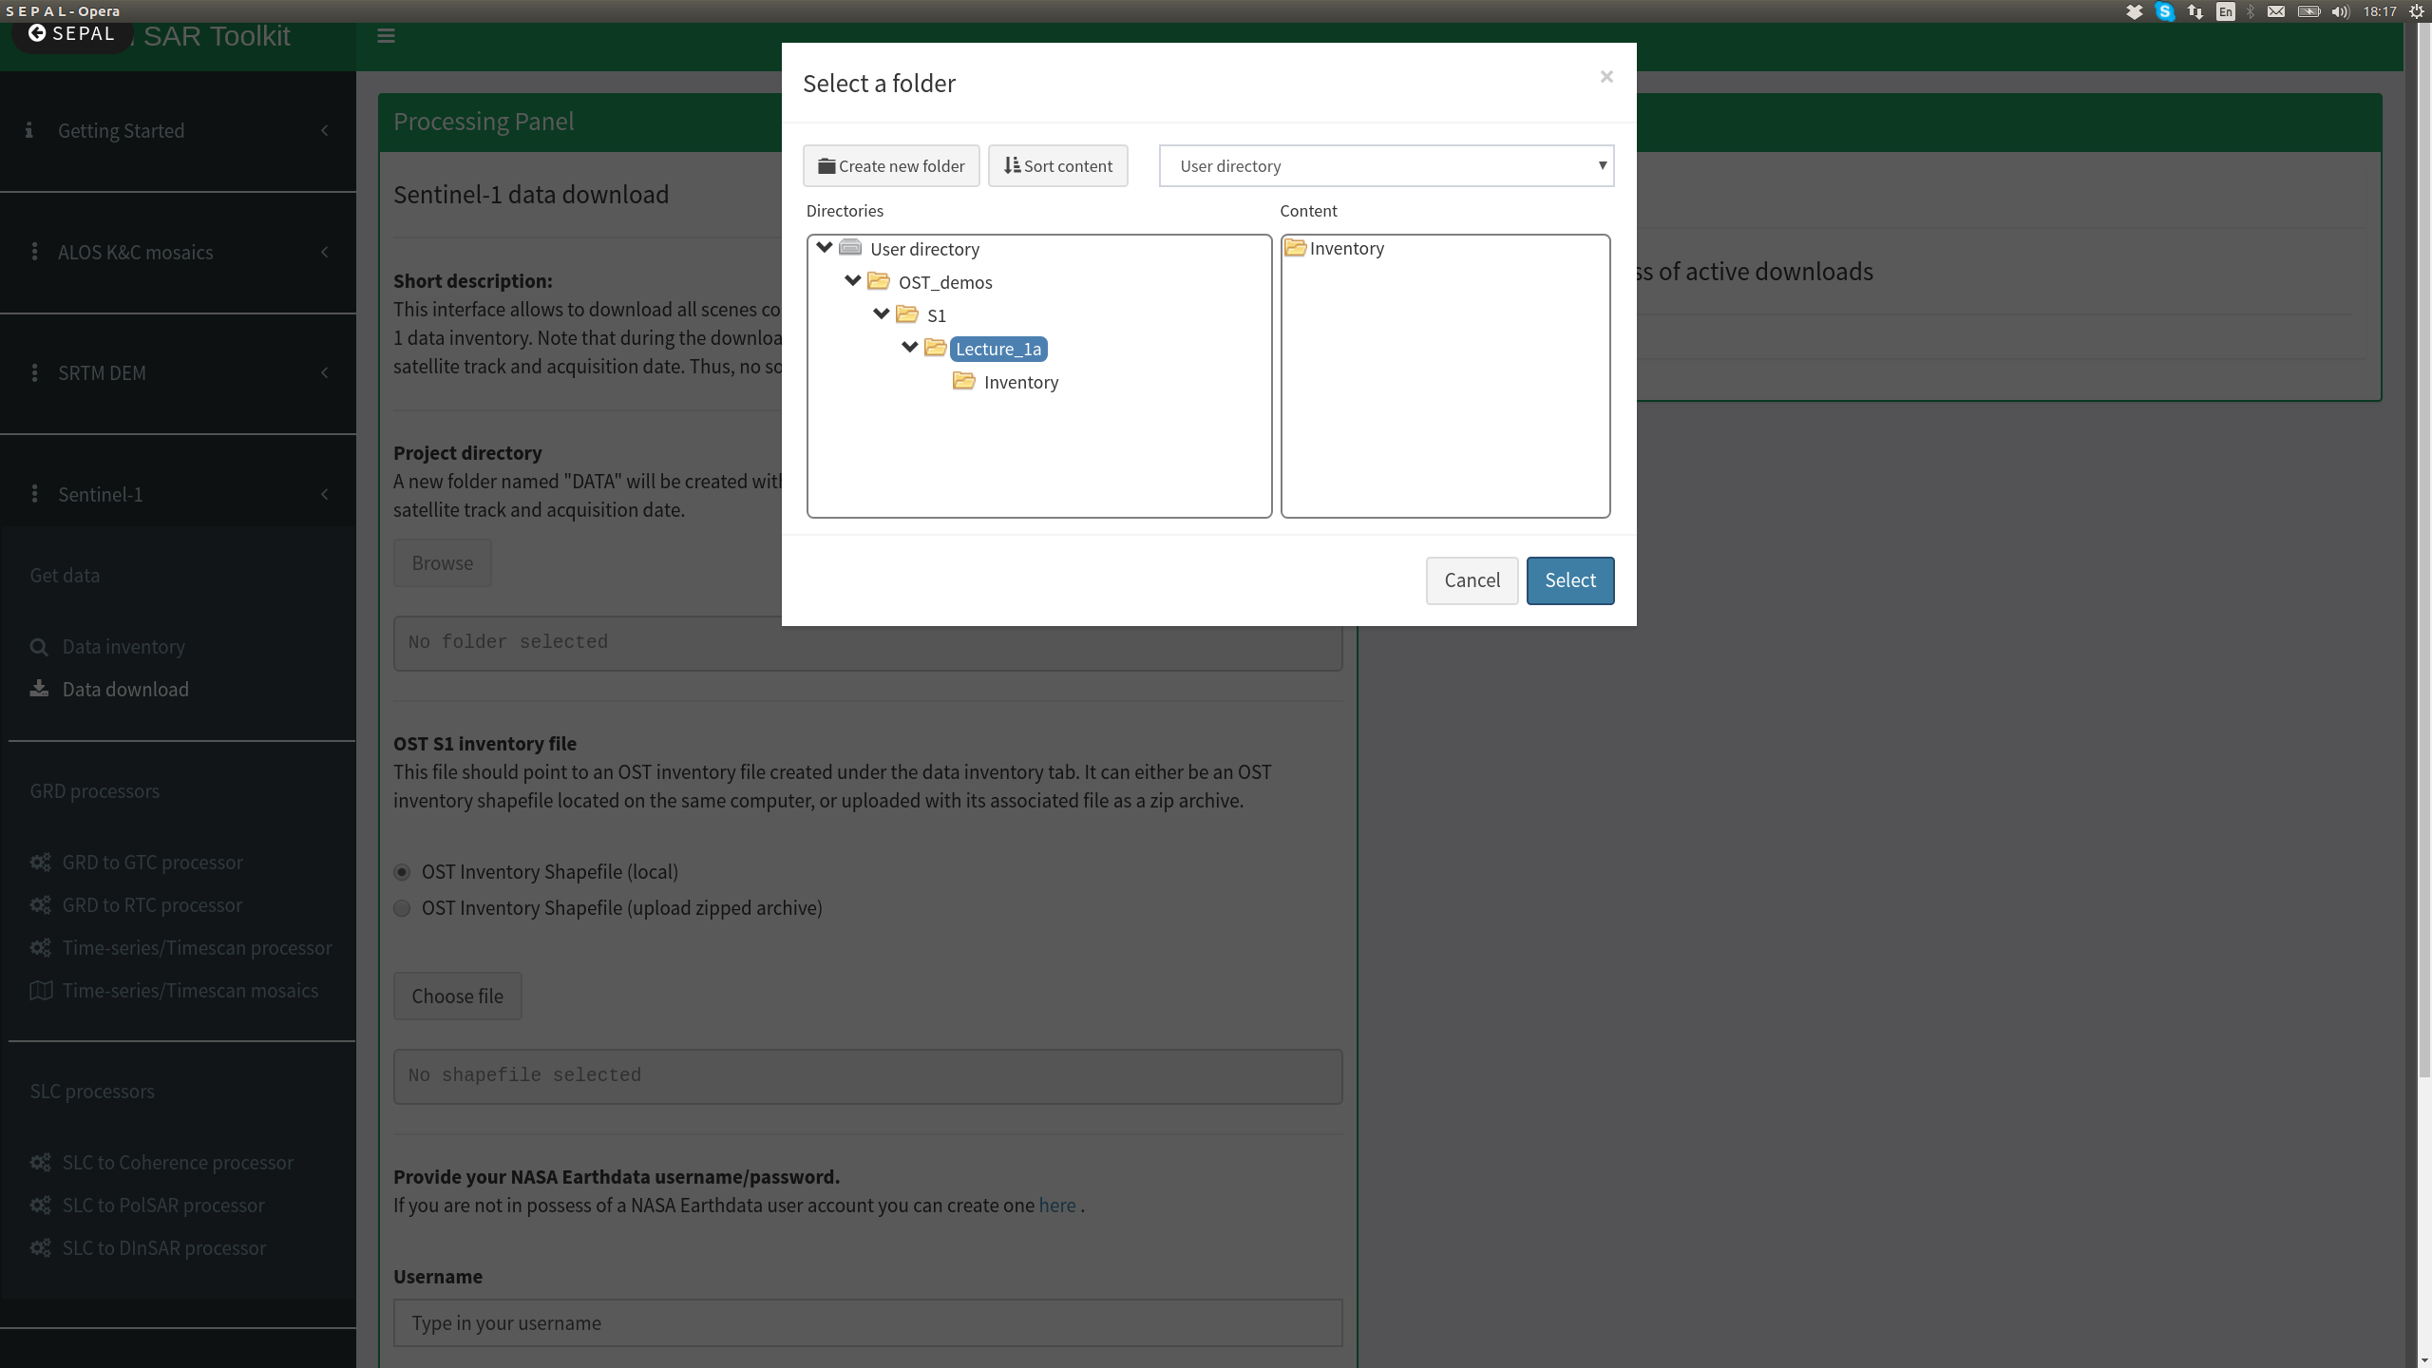
Data download
3
Select project directory
1 Go back to Data Download menu
2 Browse the project directory
3 Choose Lecture_1a within Ost_demos/S1 folder
4 Click select
2
4
1

Slide 20
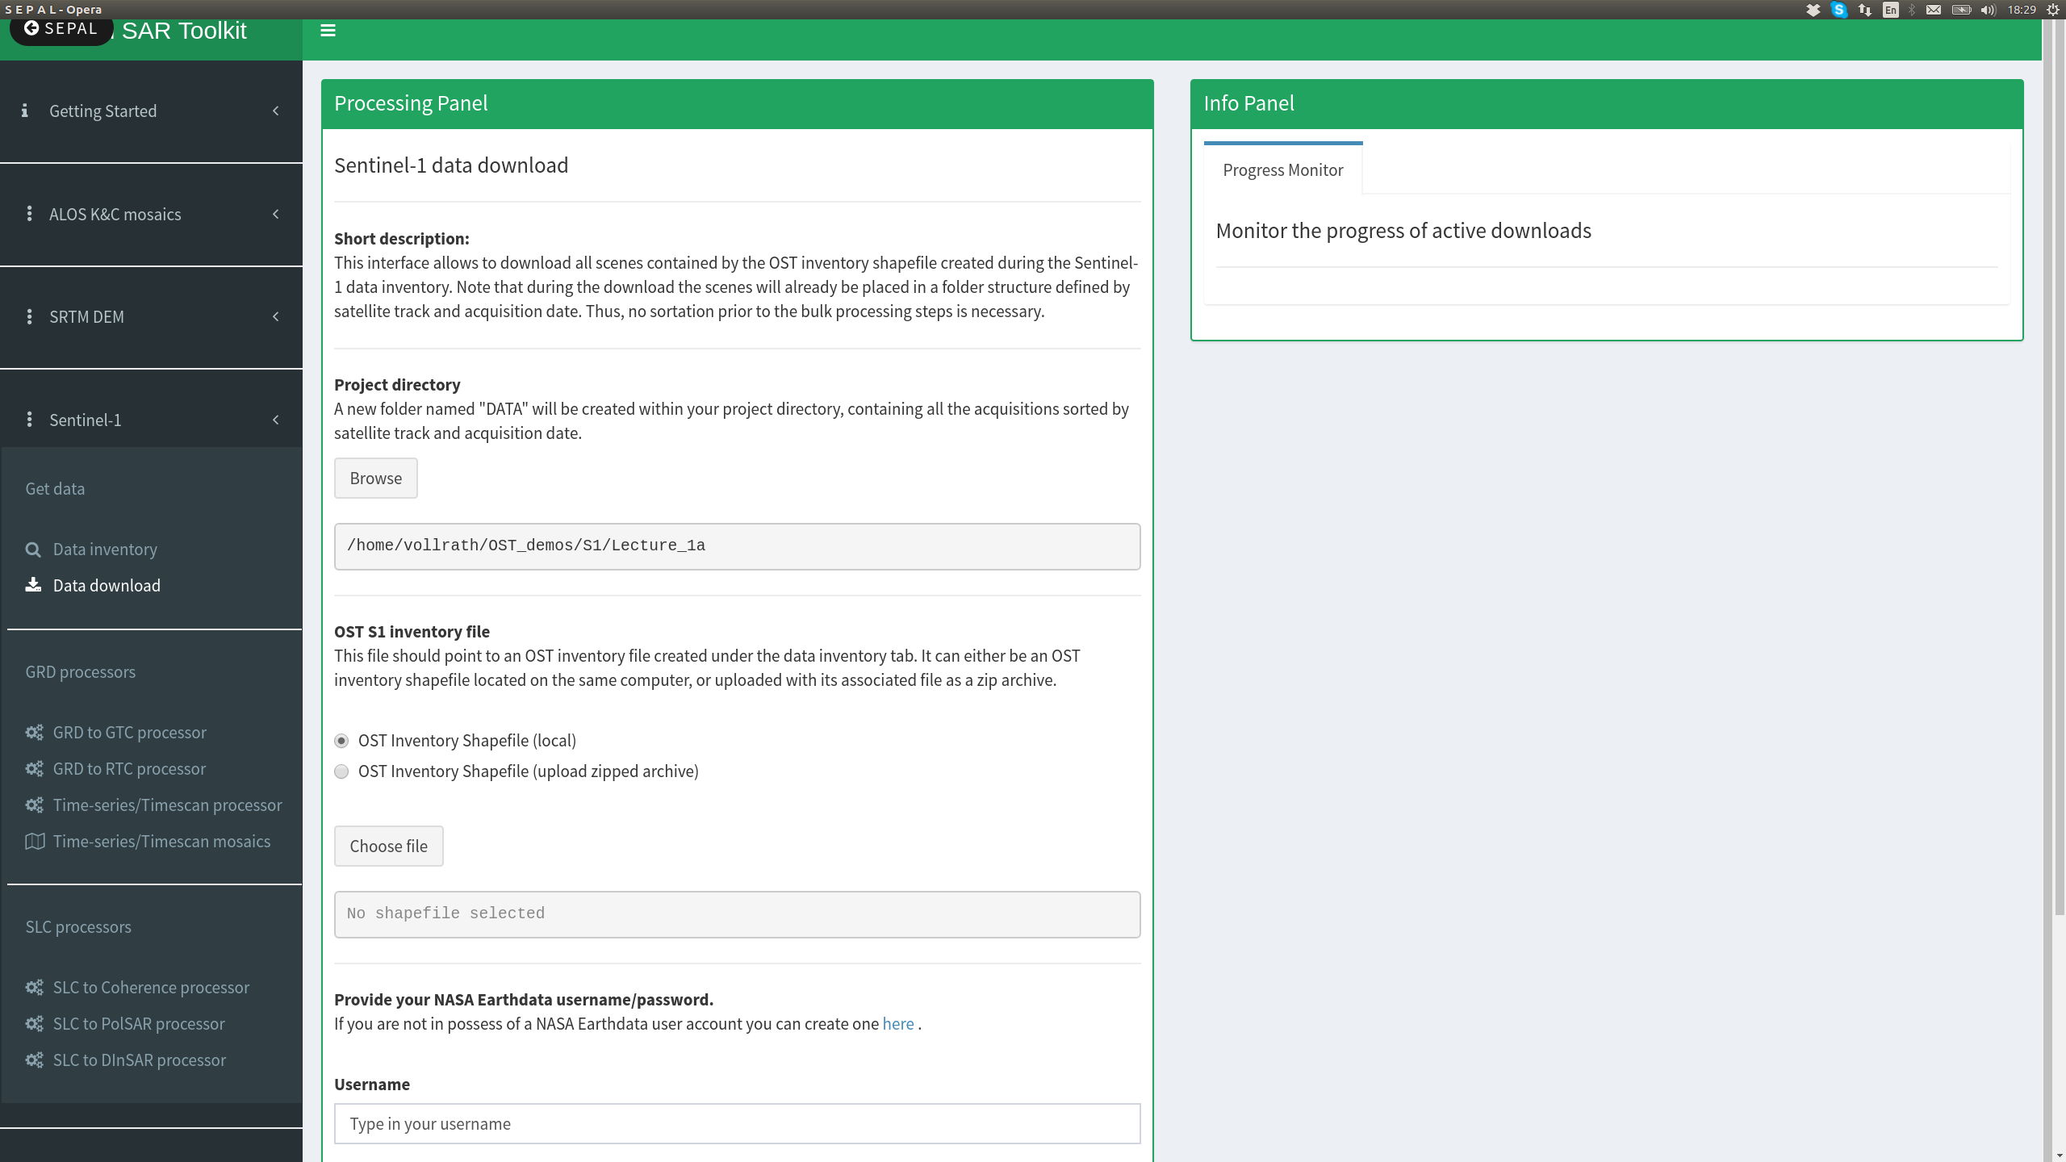
Data download
1 check if the path points to the right folder
1

Slide 21
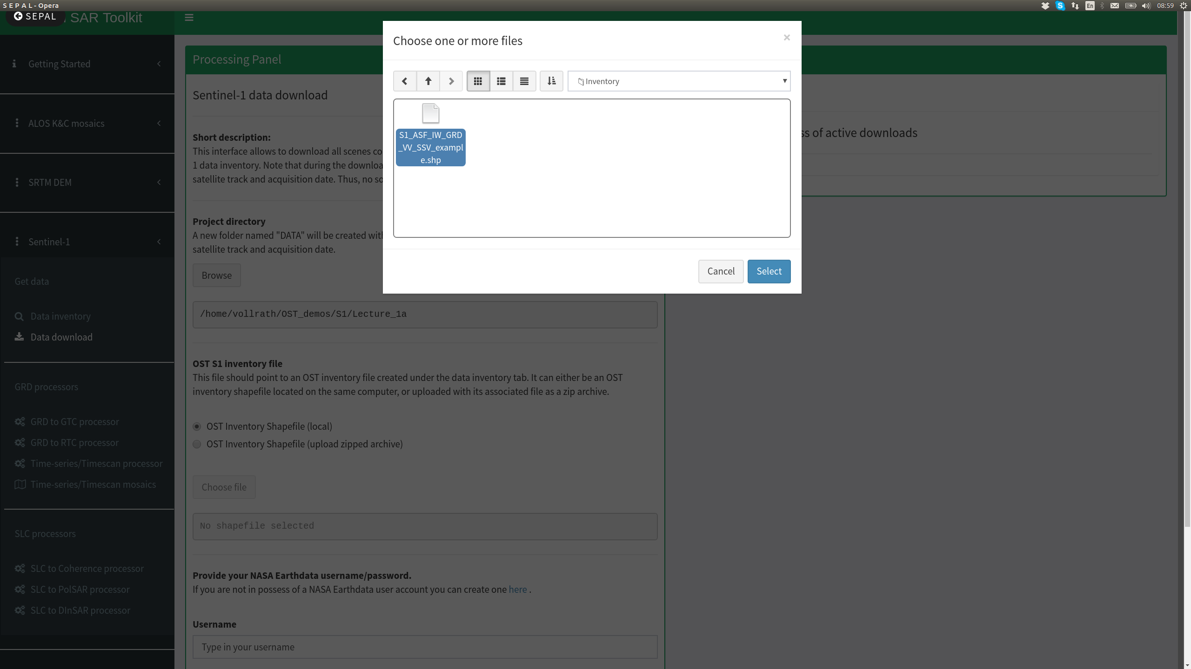
Data download
3
OST S1 Inventory file
1 Select local (since we have the file already on sepal)
Note: You could potentially upload your own OST inventory shapefile. This is for example the case when you downloaded the shapefile created by the inventory routine for editing, and then want to put it again on sepal. In this case you choose the upload zipped archive option. You should zip the shapefile and its associated files beforehand on your machine
2 Browse to the inventory shapefile, following the OST_demos/S1/Lecture_1a/Inventory path
3 Click on the shapefile
4 Click on select
4
1
2

Slide 22

Data download
The path to the shapefile should appear there

Slide 23
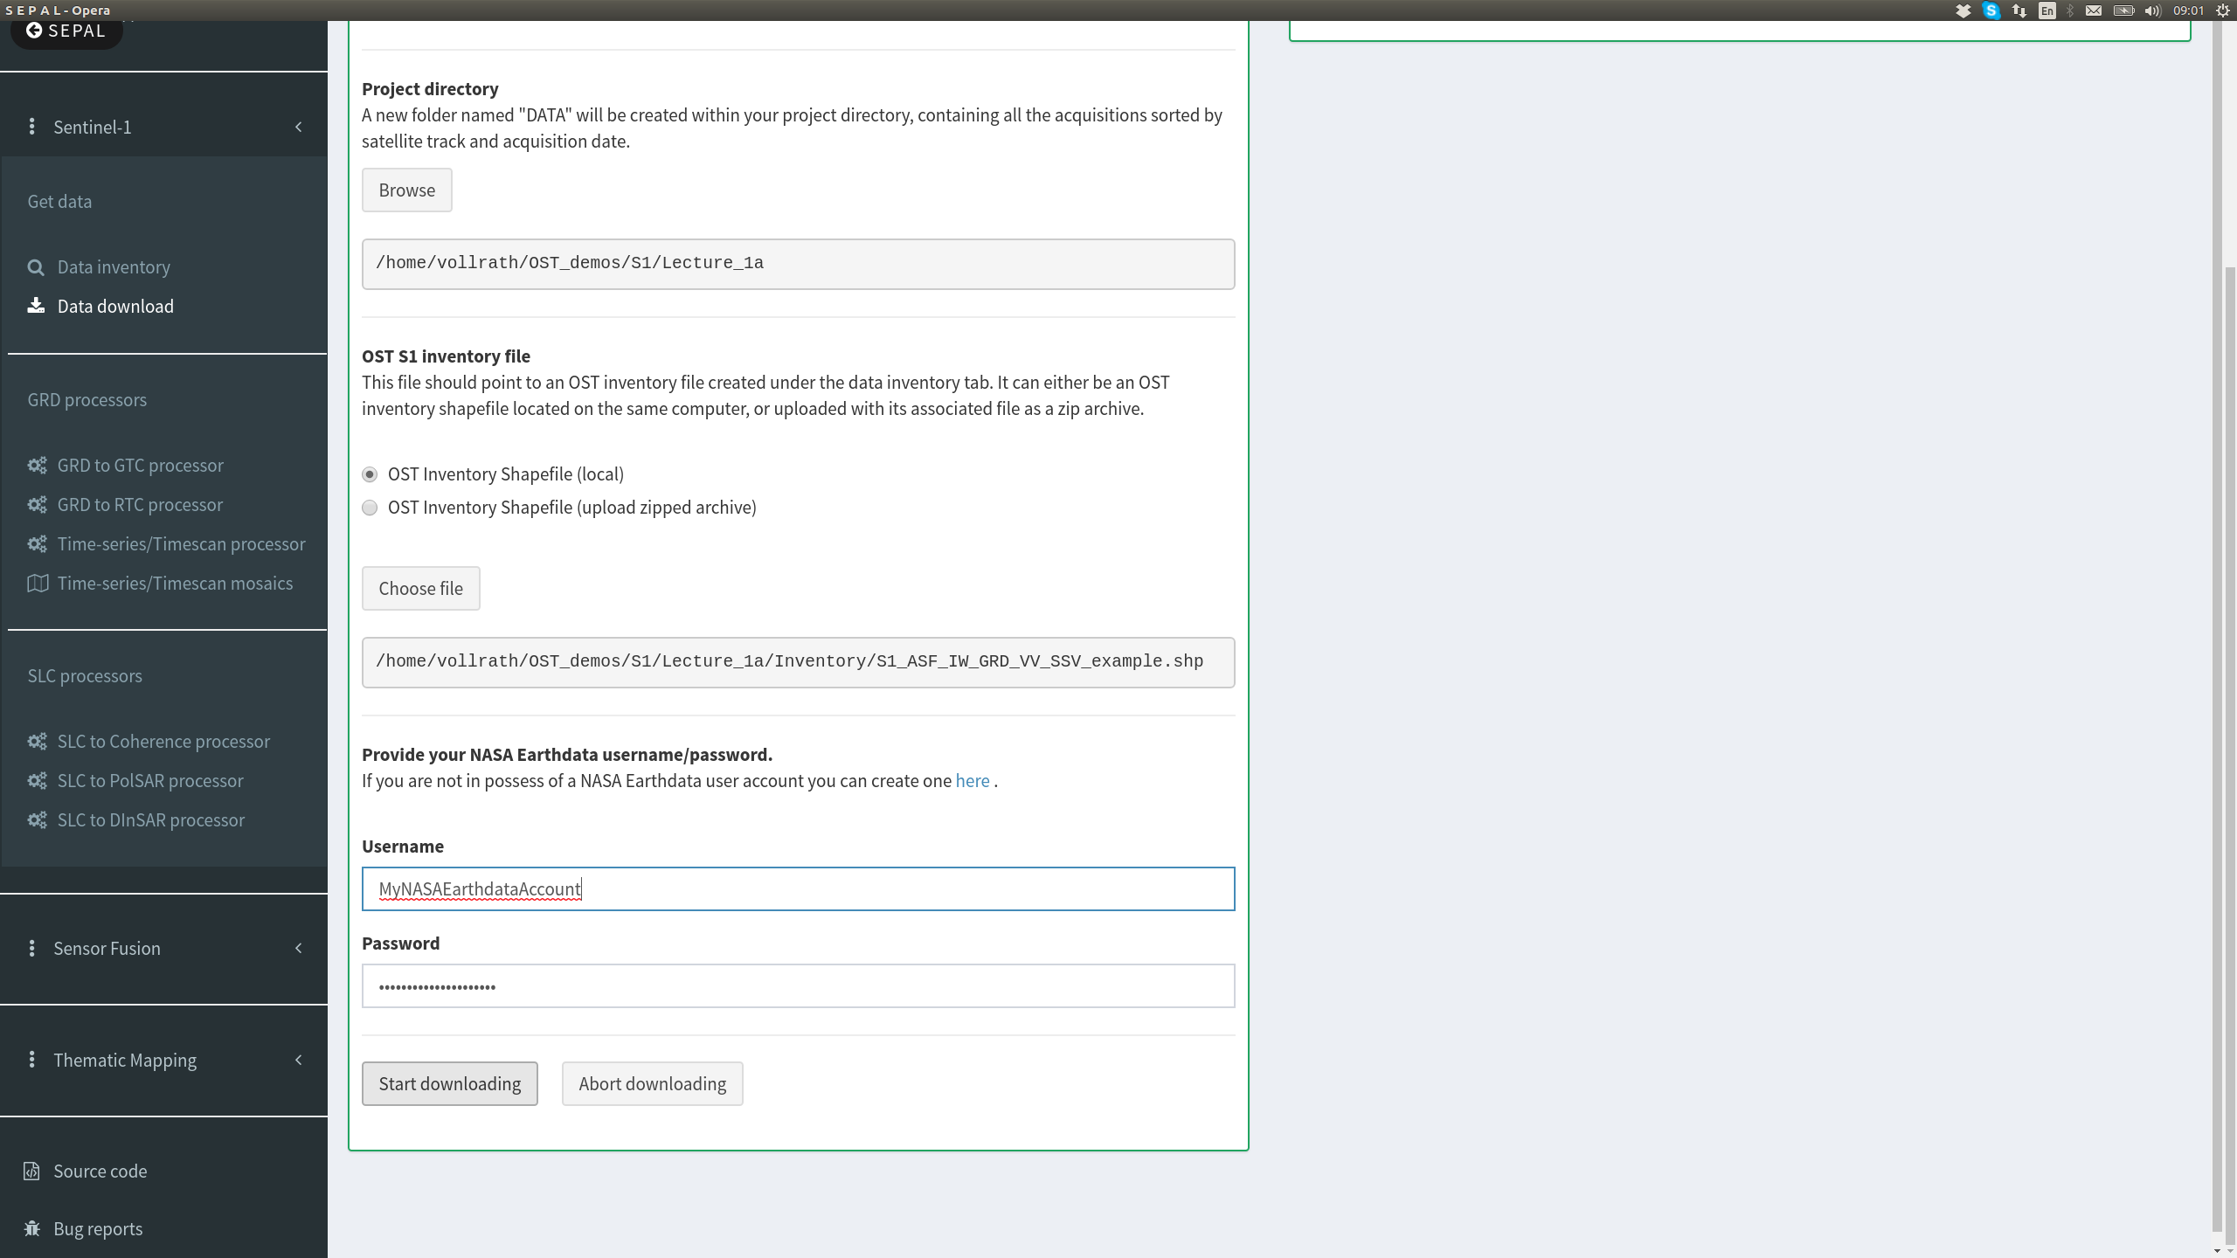
Data download
1 Put in your credentials of the NASA earthdata account
NOTE: Make sure ASF Data centre is enabled in your MyApplications within your earthdata profile
Start downloading
1
2

Slide 24
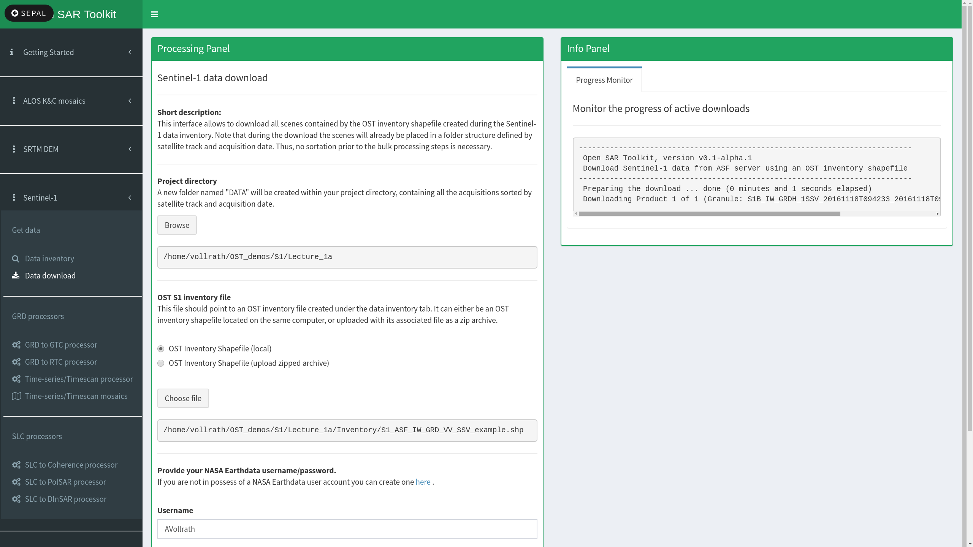
Data download
Look what's going on in the progress monitor

Slide 25
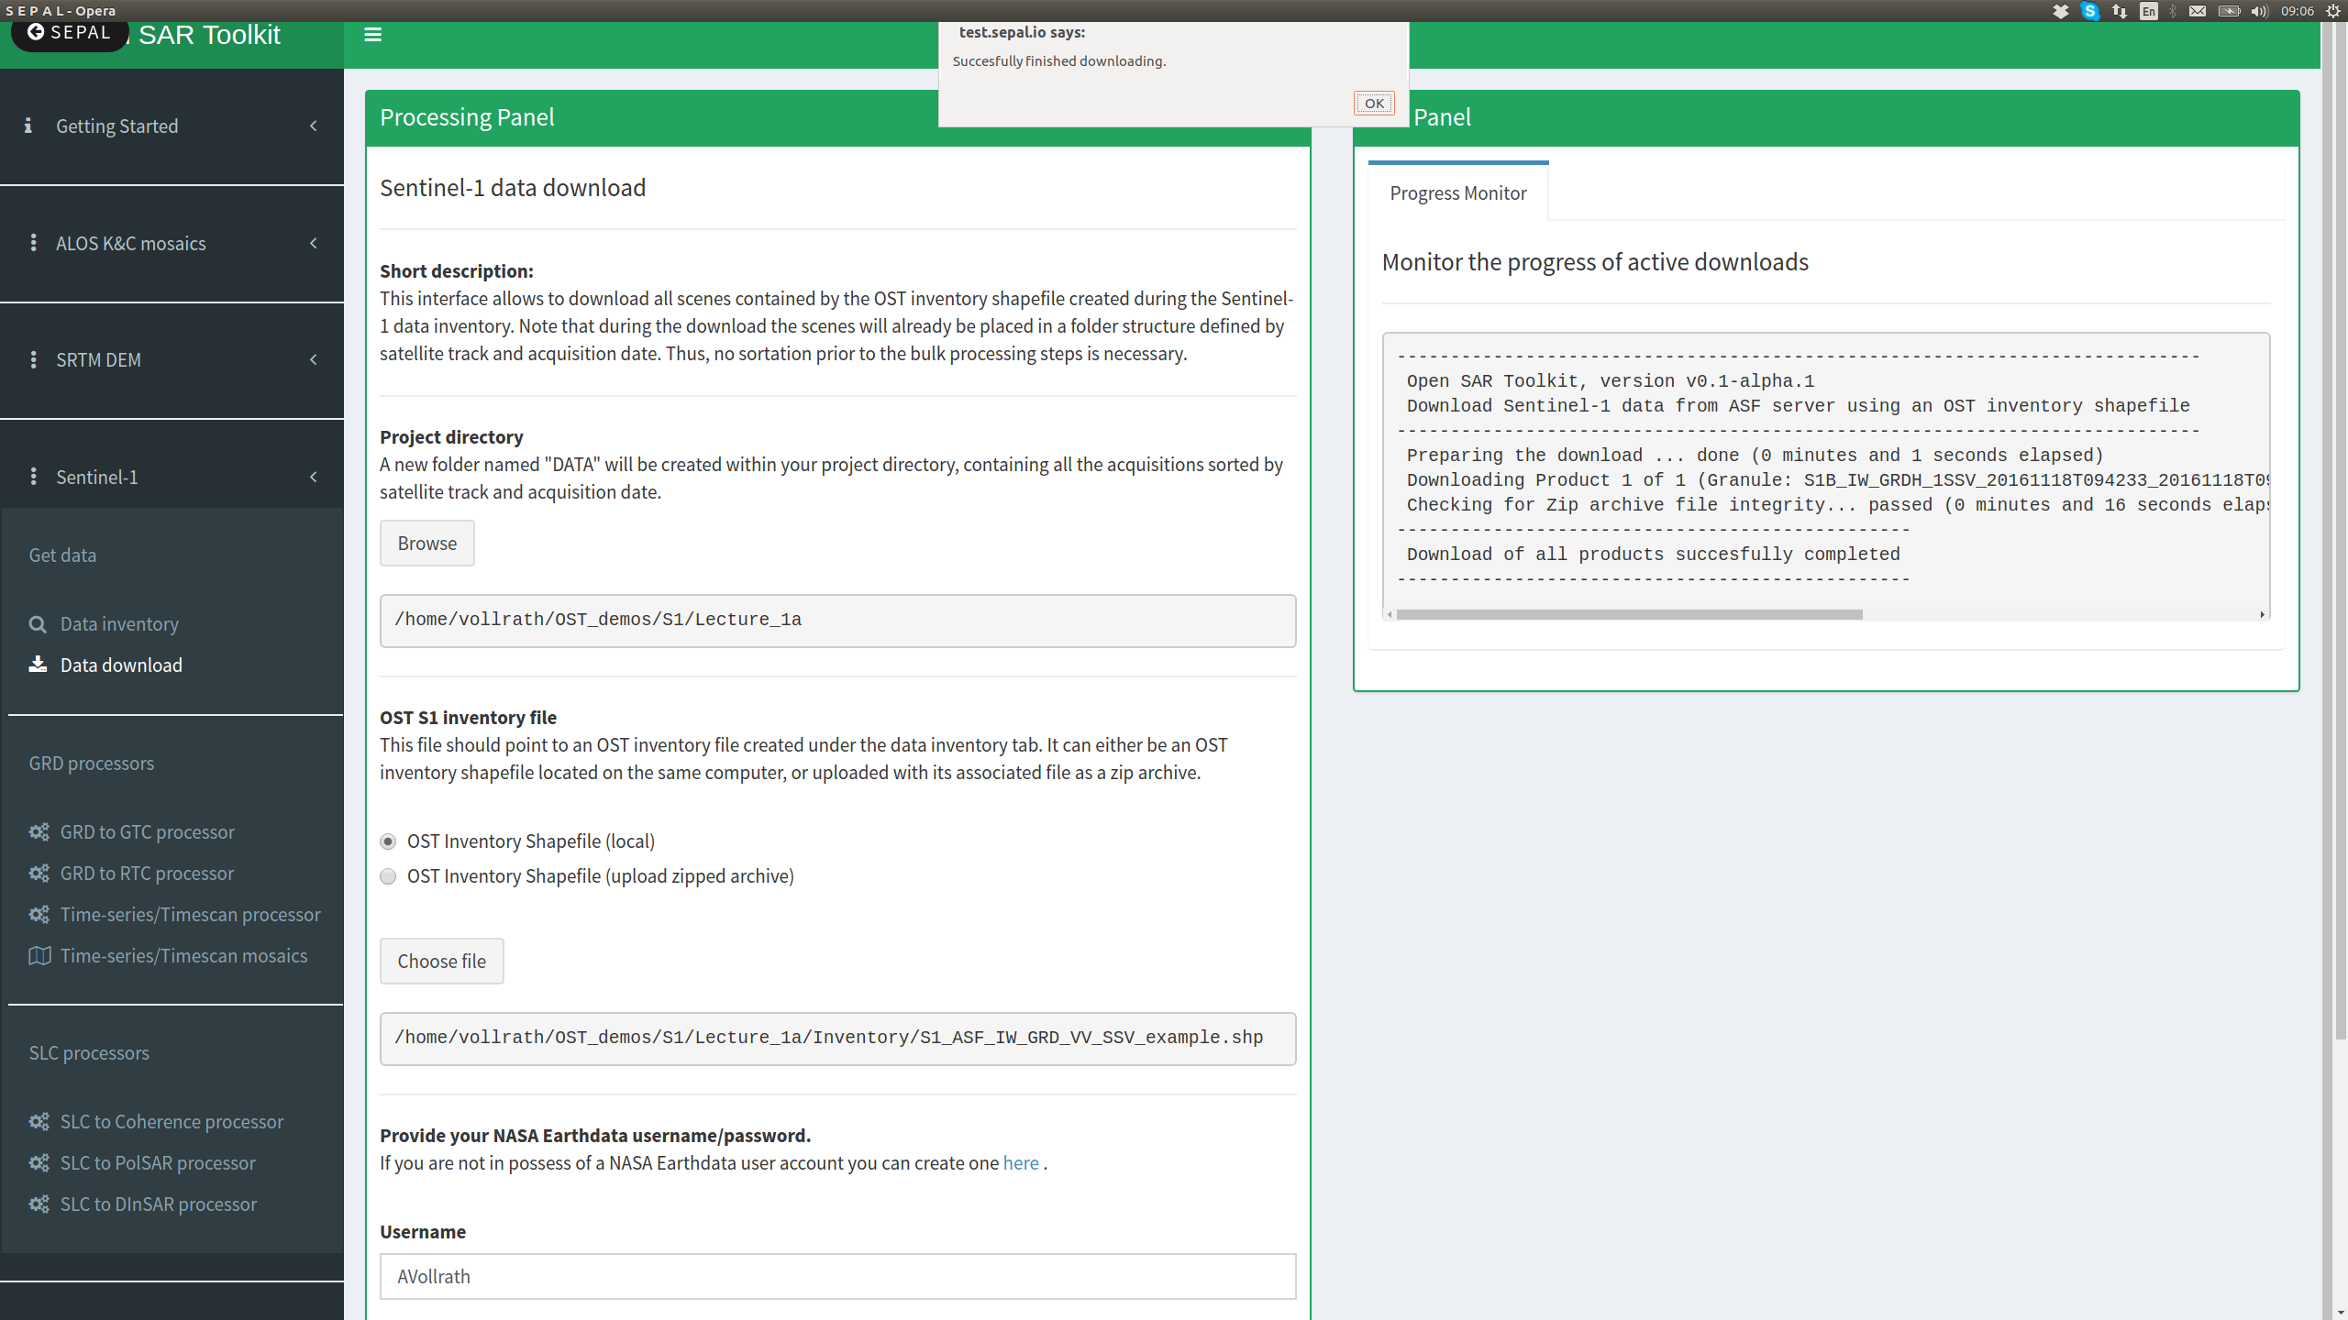
Data download
Wait until this little window pops up telling you the file(s) has been successfully downloaded

Slide 26
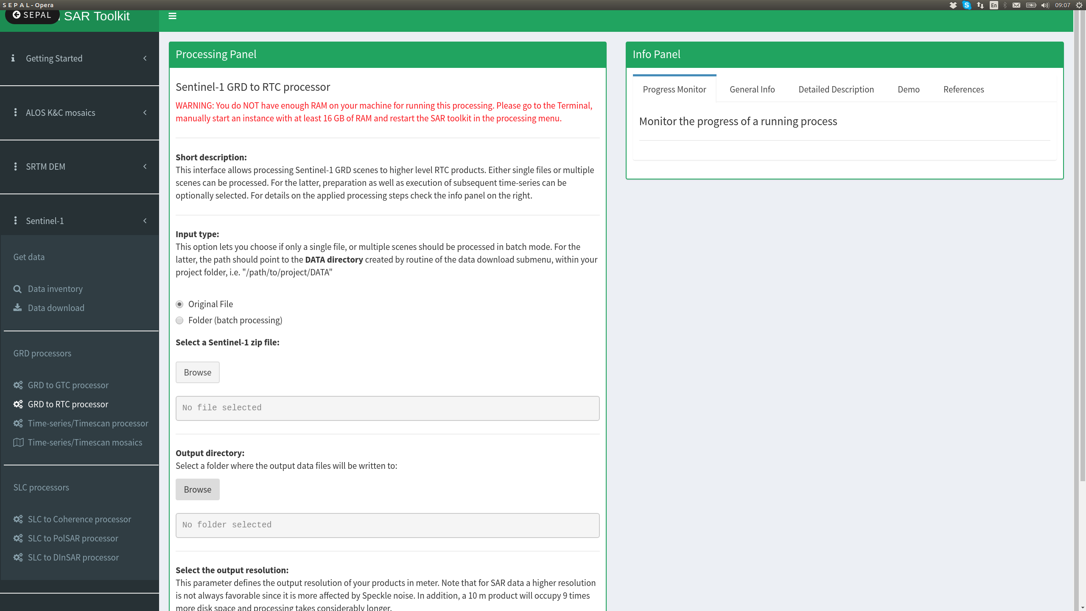
Data processing
2
1
Go to GRD to RTC processor
1 Note the warning on top!
NOTE: OST is running by default on the smallest amazon instance (1 CPU, 2GB RAM). This is not sufficient for Sentinel-1 data processing
2 go back to sepal main interface to start a bigger instance

Slide 27
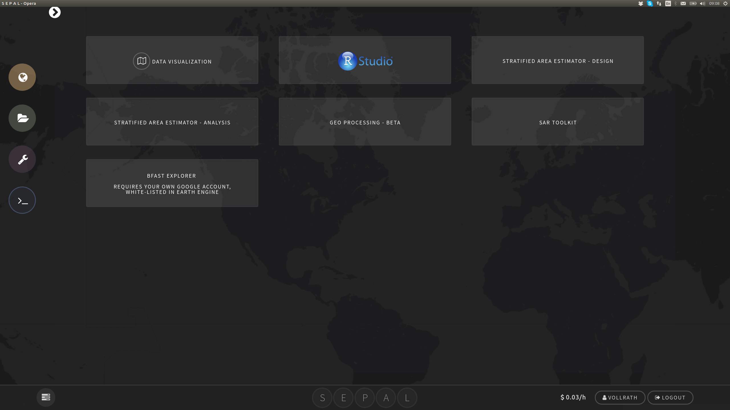
Launch big amazon instance
Launch the terminal

Slide 28
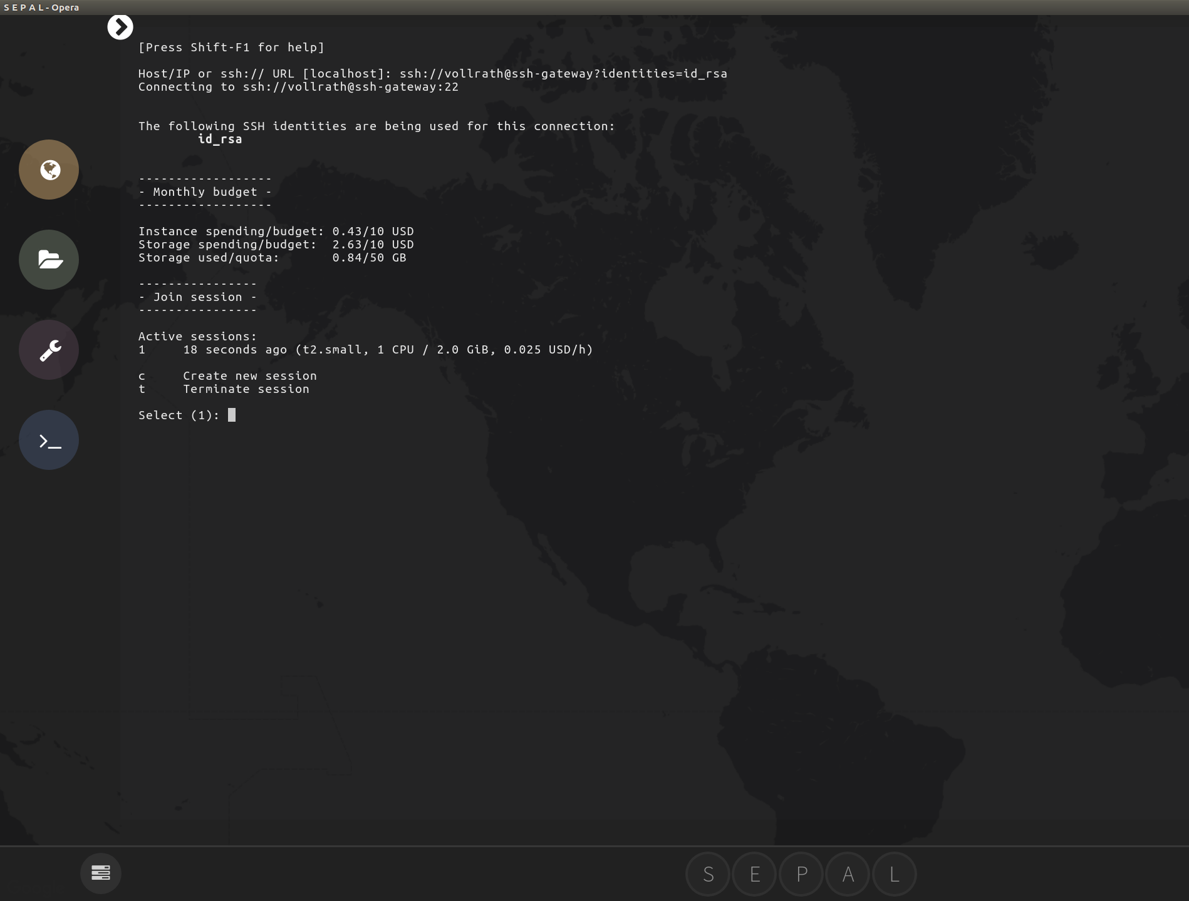
Launch big amazon instance
1
Leave your mouse alone for a moment :)
1 Note your active session
2 note the functionality for terminating/creating sessions
2

Slide 29
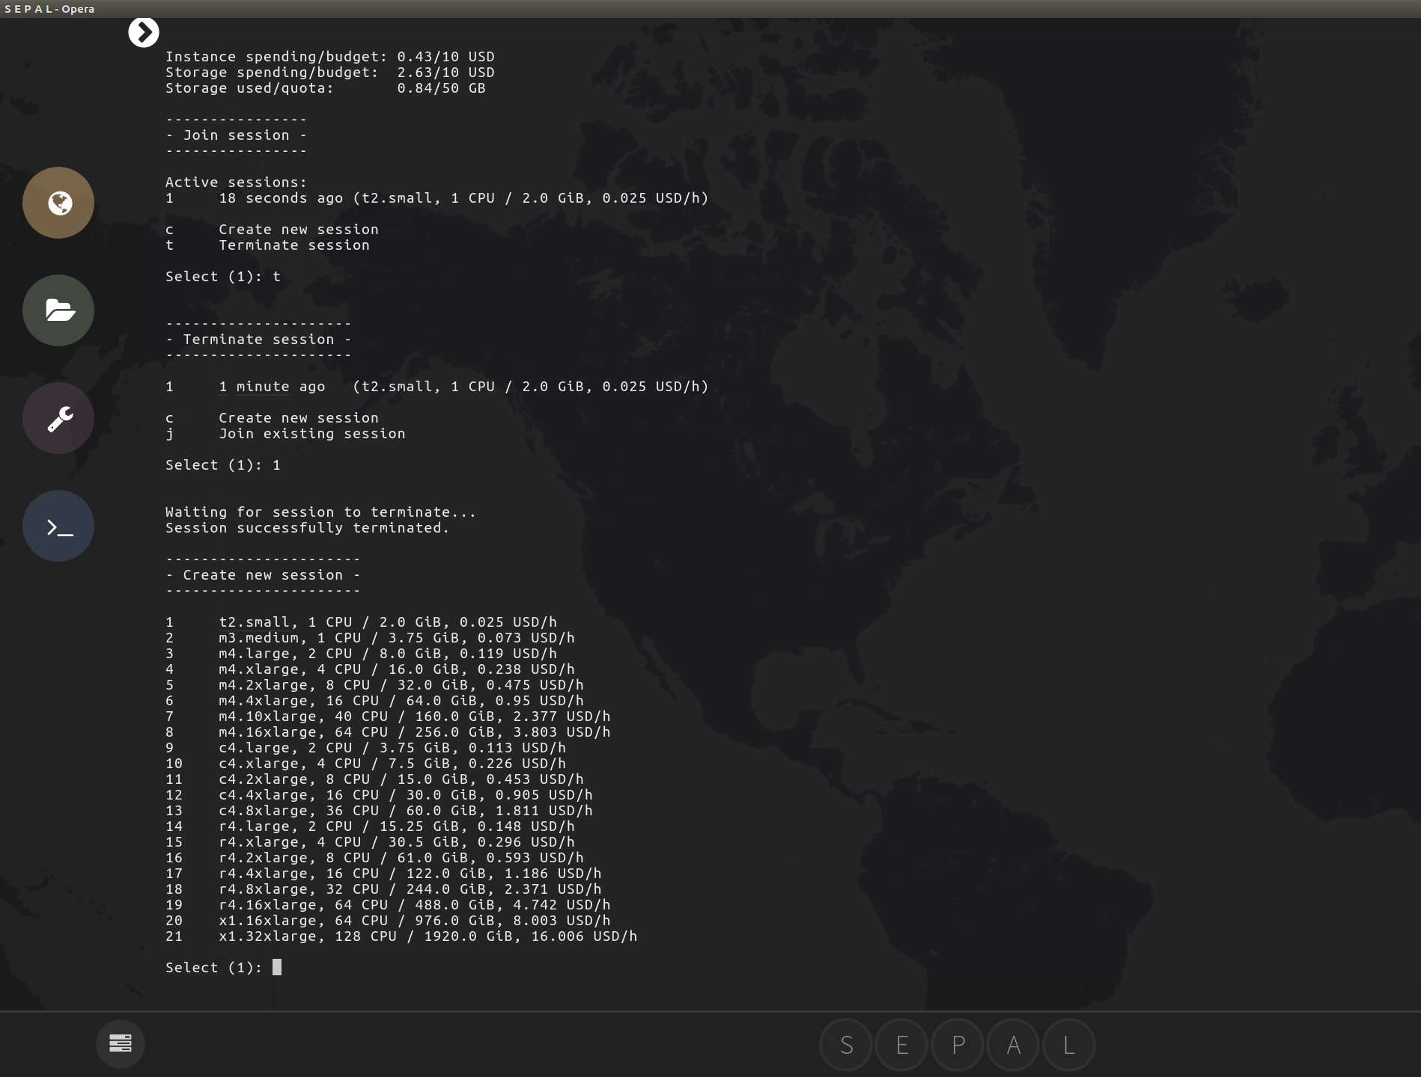
Terminate active session
1
1 switch to the termination menu by typing T and pressing ENTER
2 type 1 for selecting instance number 1 and press enter for terminating
3 the create new session menu will appear automatically
2
3

Slide 30
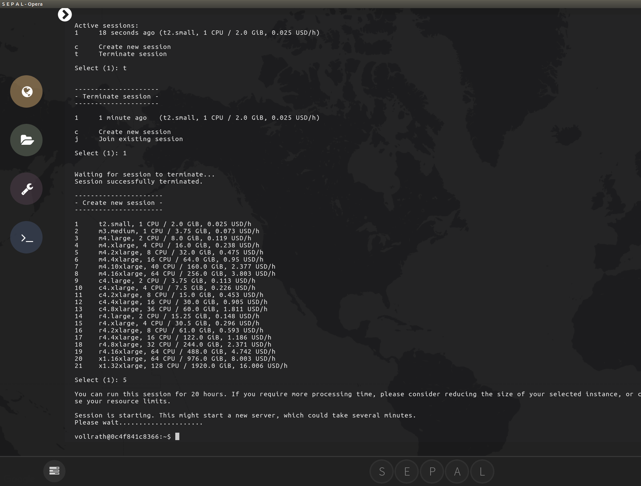
Create new session
3
Launch amazon machine of your choice
1 select machine number 5 (8 CPUs, 32GB RAM) by typing 5 and press ENTER
2 wait until the machine has started and the cursor behind your username@machine id is blinking
3 go back to processing modules and relaunch the SAR toolkit
1
2

Slide 31
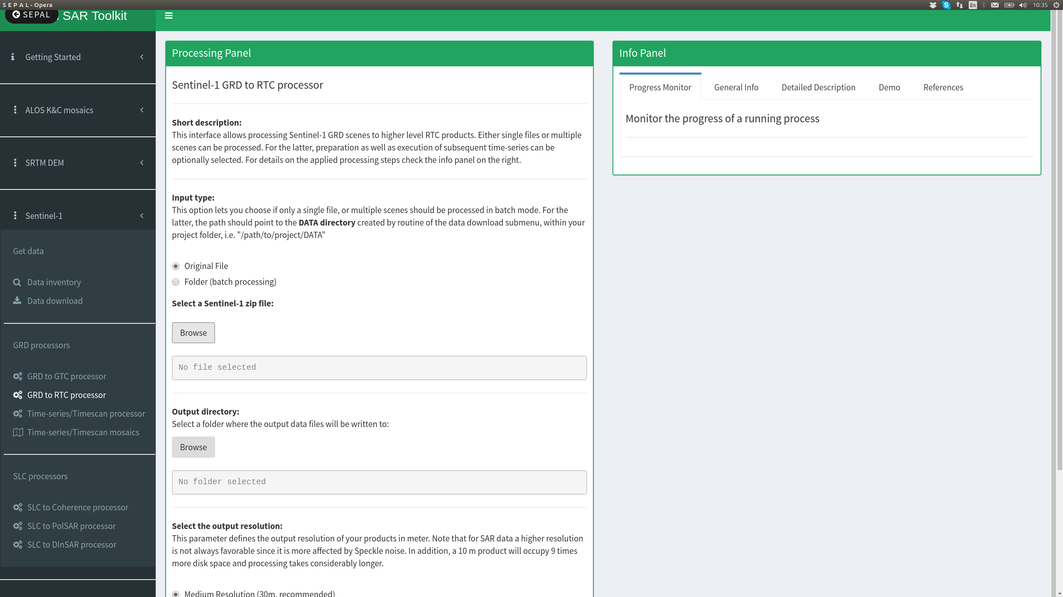
Rtc processing
1 go to the Sentinel-1 --> GRD to RTC processor
2 Leave Input type as Original file and click on browse
2
1

Slide 32
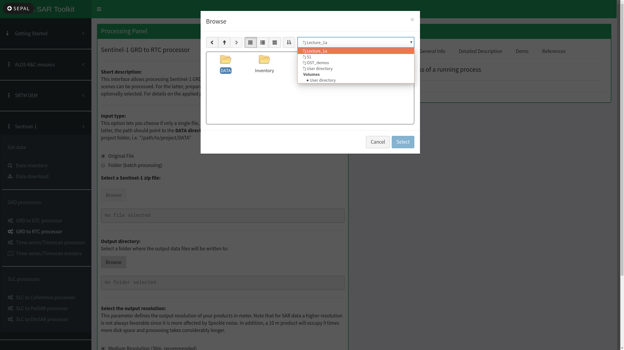
File location
Remember our project folder selected in the data download menu (I.e. Lecture_1A) and navigate there
The download procedure has automatically created a DATA folder where all downloaded products are stored in a predefined structure

Slide 33
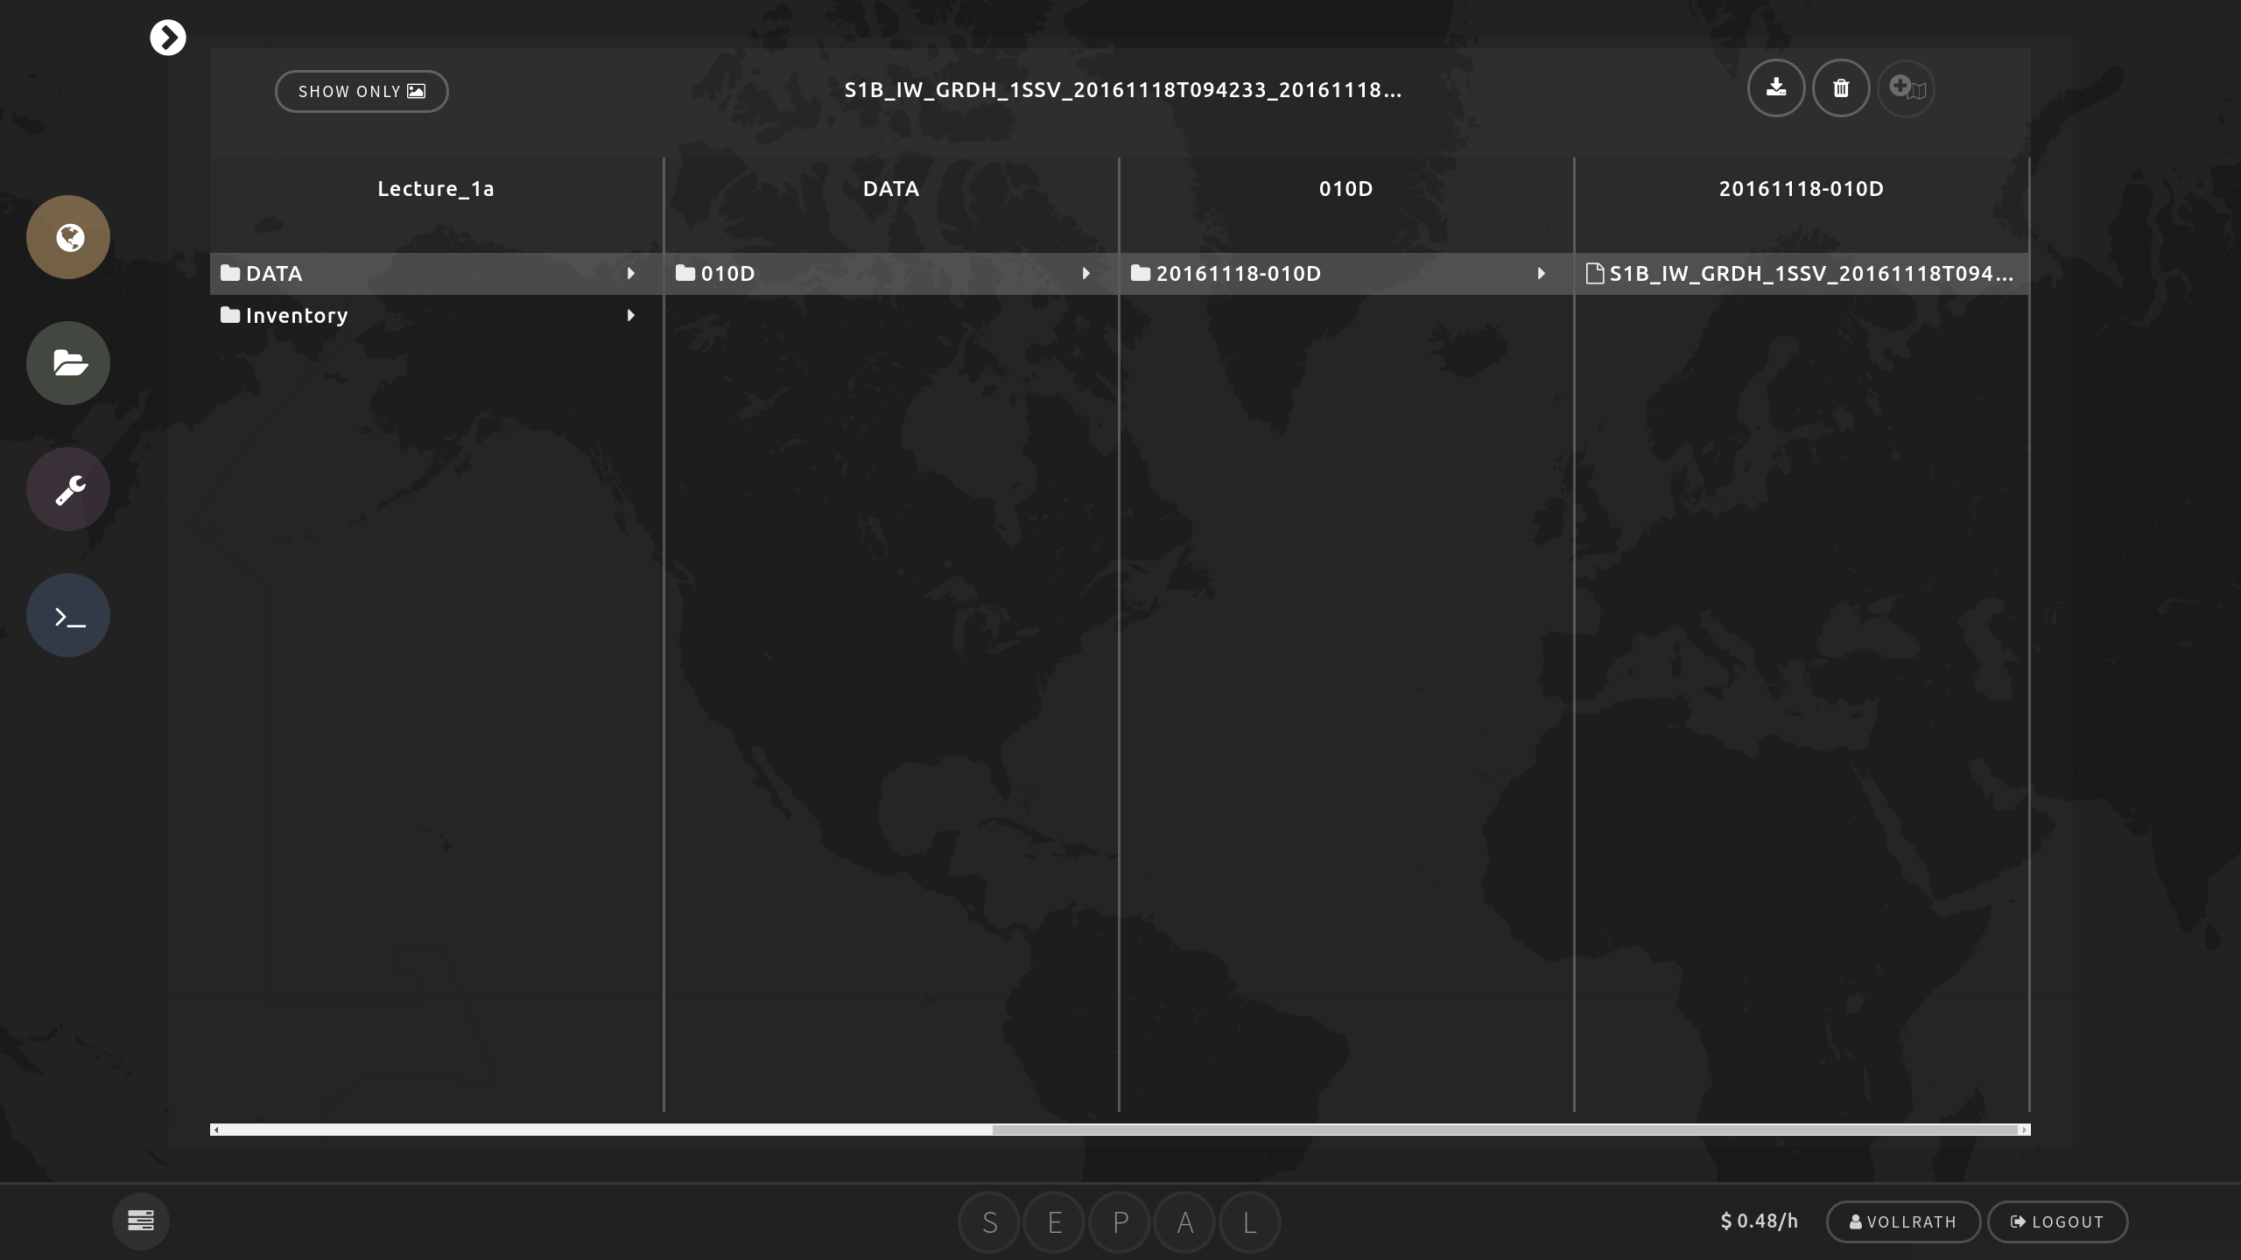
File location
1
2
3
In the sepal browser we can see that within the data folder:
1 there is a folder named 010D, which is the track number (010)and direction (D for descending)
2 Within the track folder there is a folder with the acquisition date (20161118 = YYYYMMDD)
3 Within this folder we have our actual scene starting with S1B_IW_...

Slide 34
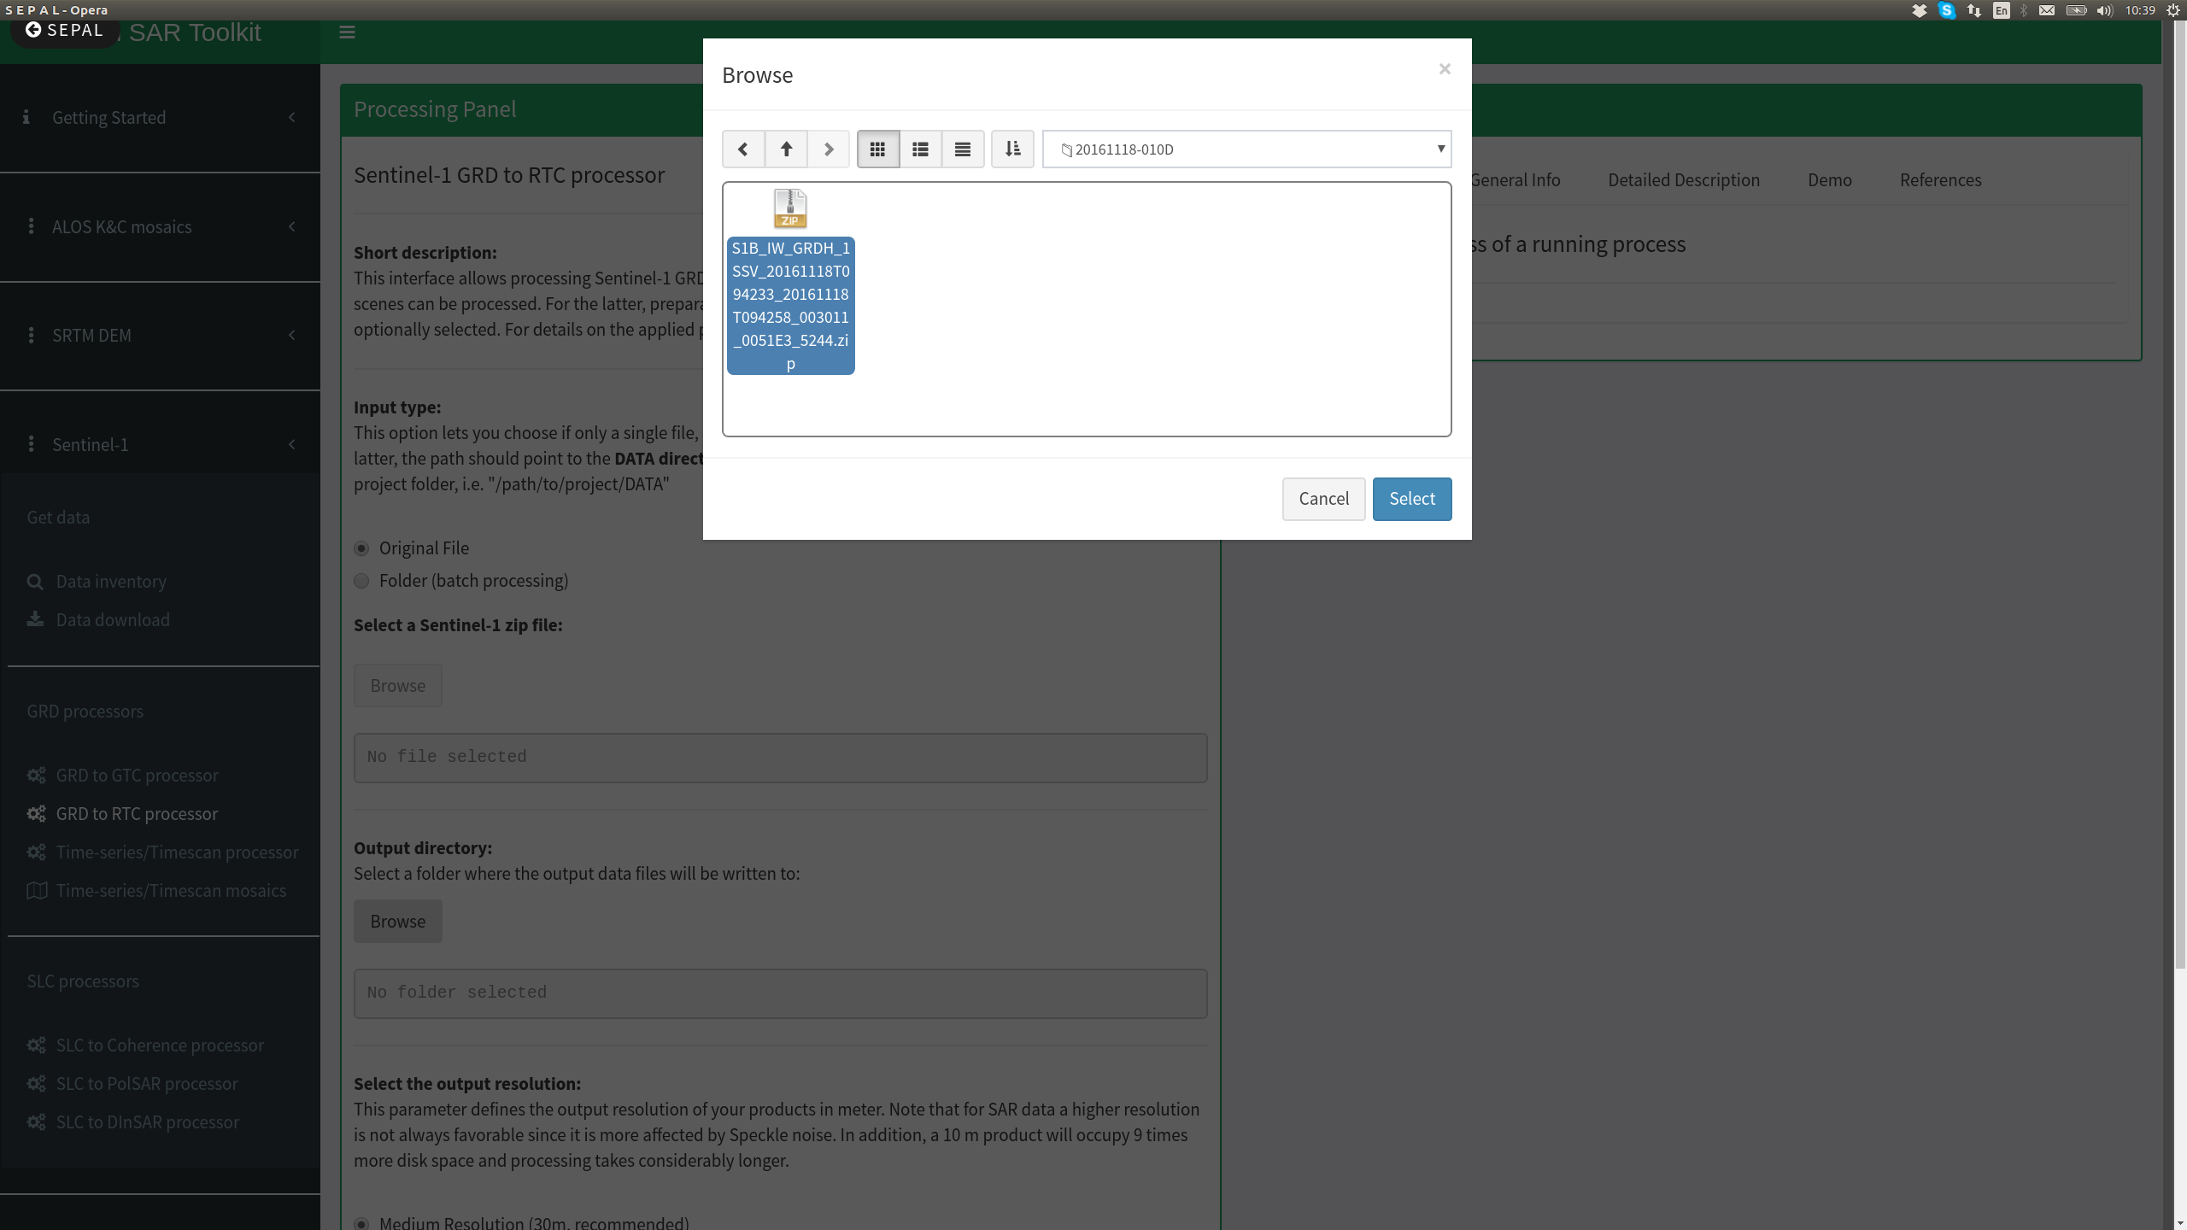
File selection
1
Now that we know where our download is stored:
1 go to the folder and select the scene by clicking on it
2 Confirm your selection by clicking select
2

Slide 35
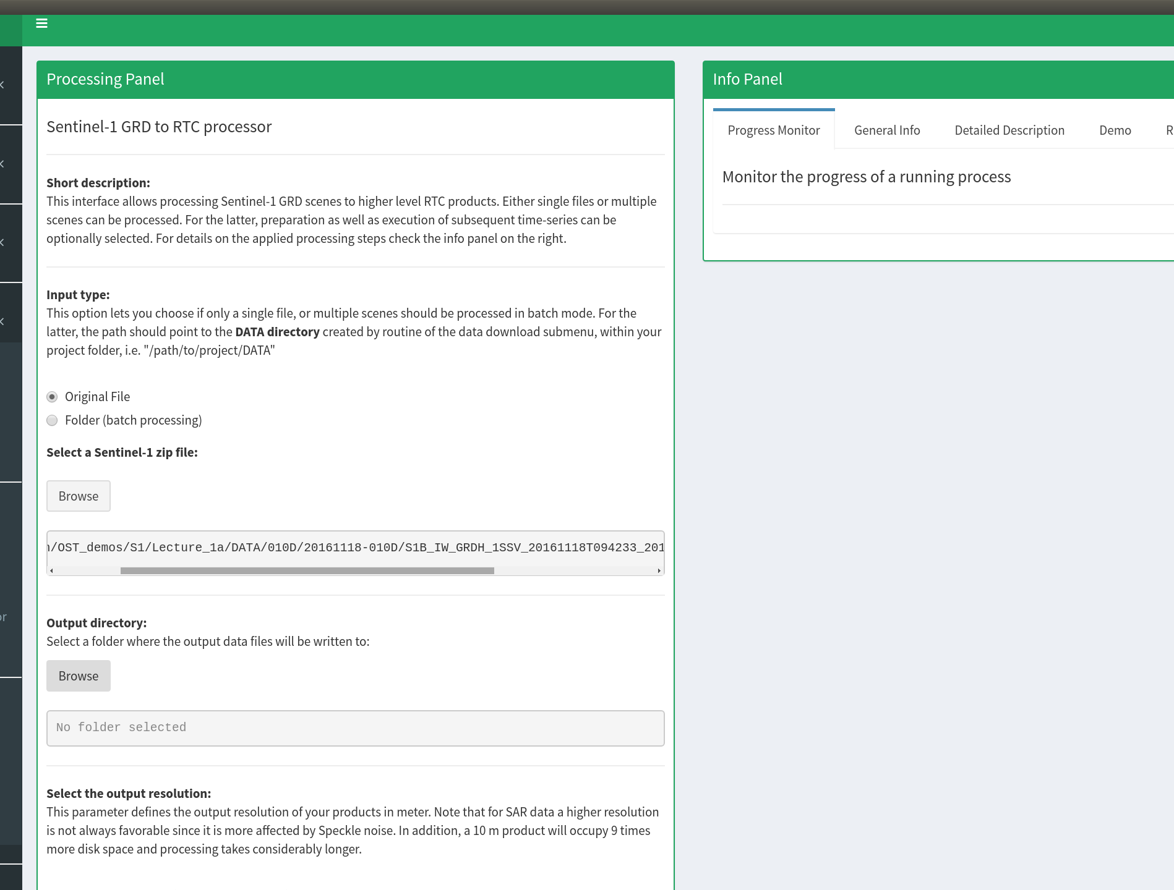
Output directory
1 Check if the path has been set correctly
2 Go to Browse for your Output directory
Here your processed file will be stored
1
2

Slide 36
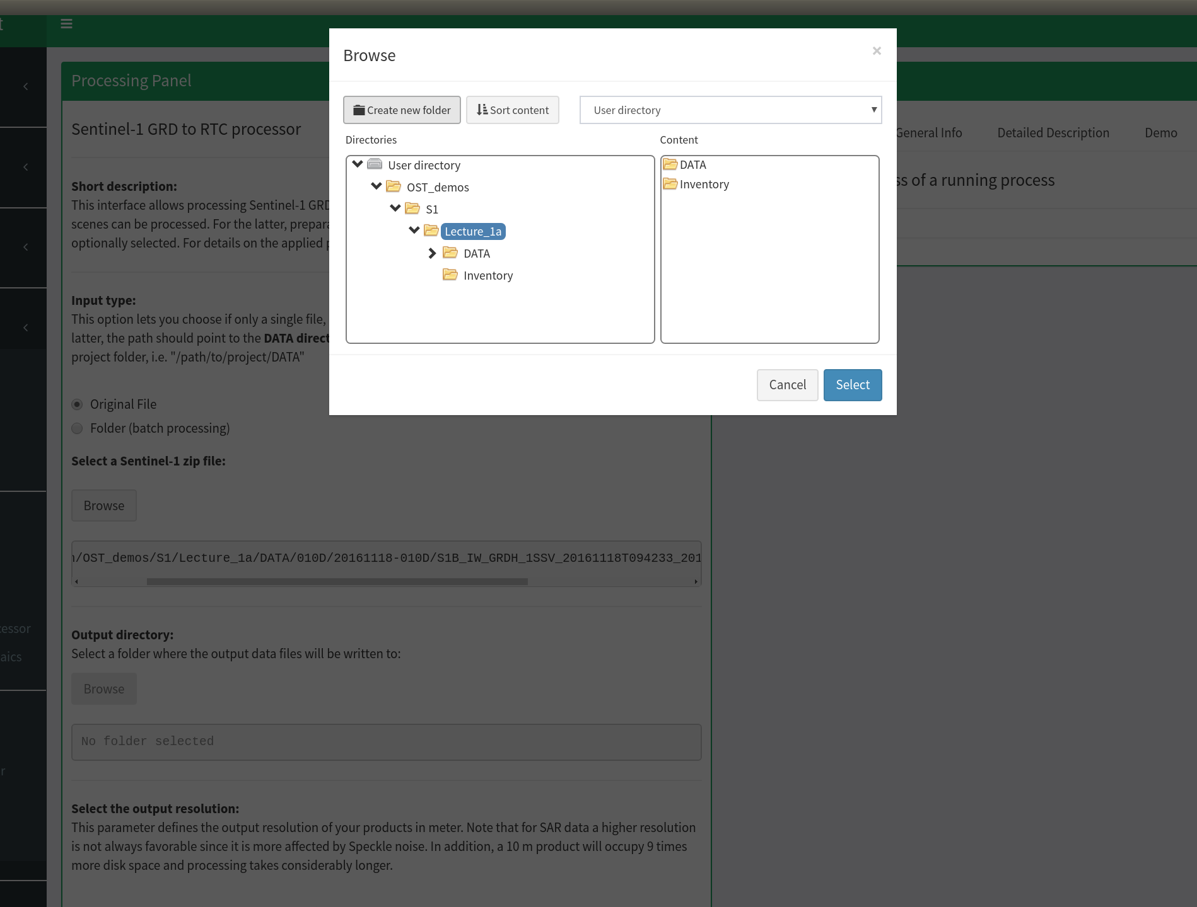
Output directory
2
1
1 Follow the path to your project directory by clicking on the arrows and select Lecture_1a by clicking on it
2 Click on create new folder

Slide 37

Output directory
1
1 Type in the opened window RTC and press enter
This is going to create the folder RTC within your project directory

Slide 38
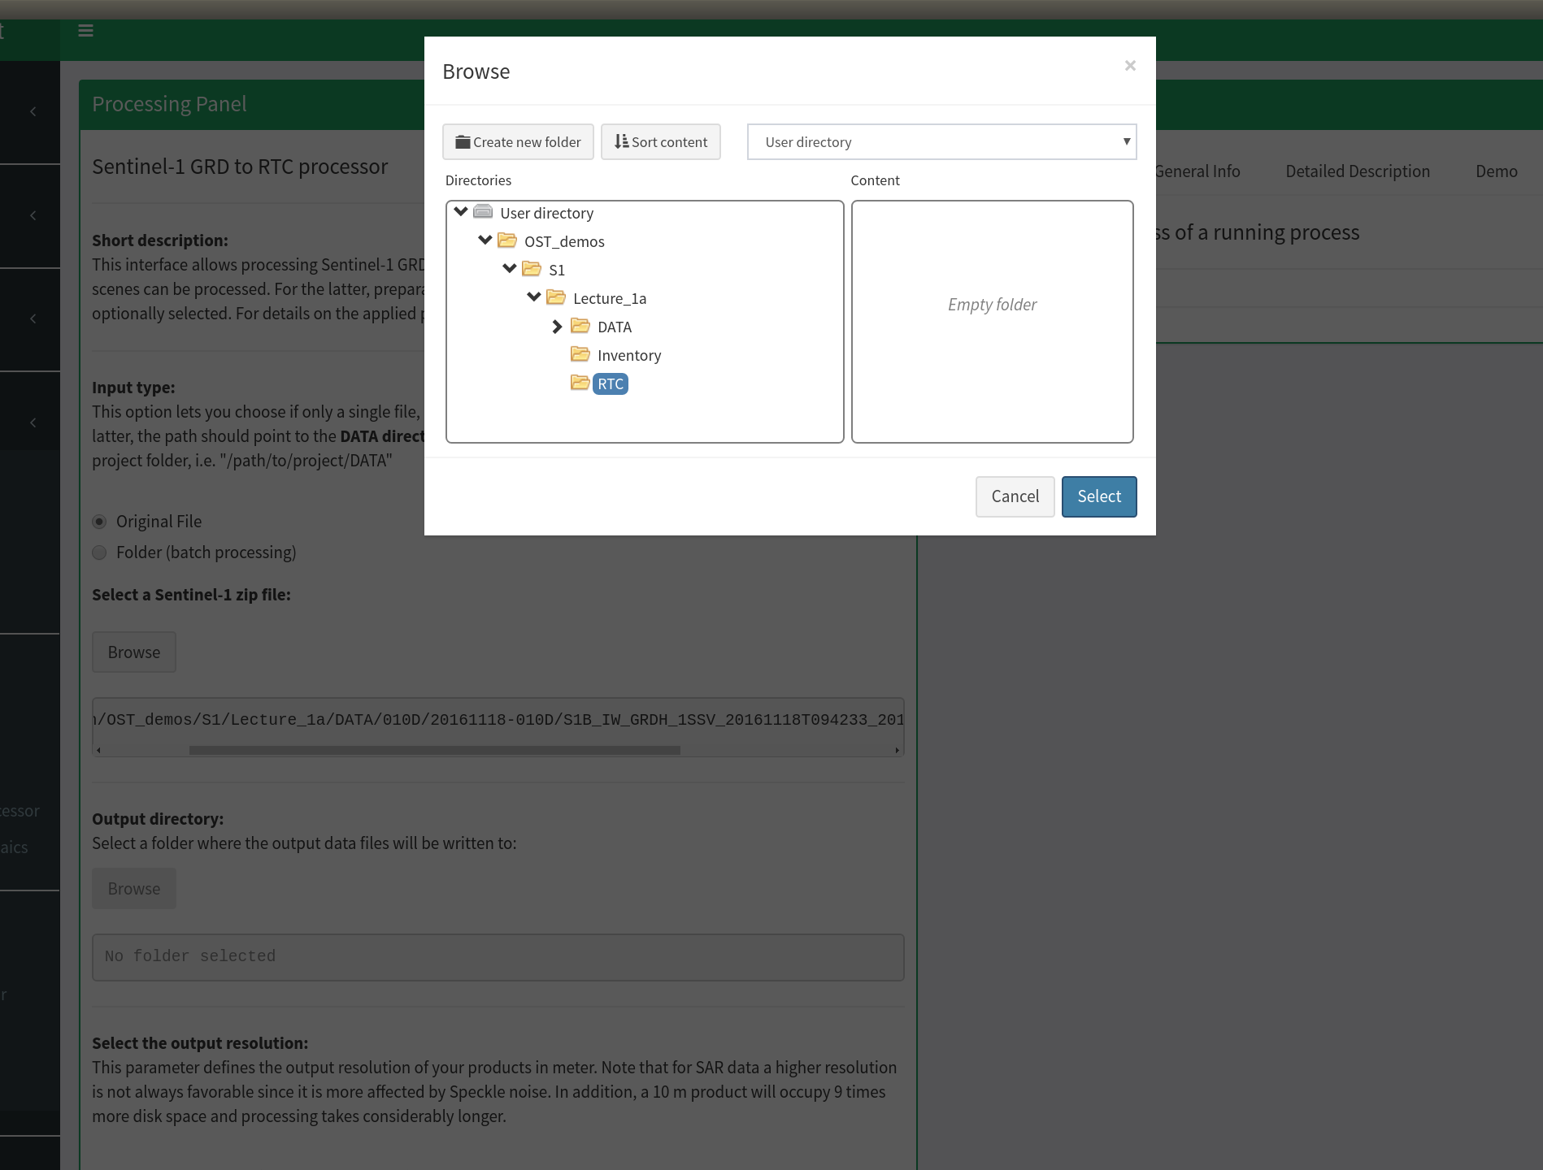
Output directory
1
1 Select the newly created RTC folder by clicking on it
2 confirm your selection by clicking select
2

Slide 39
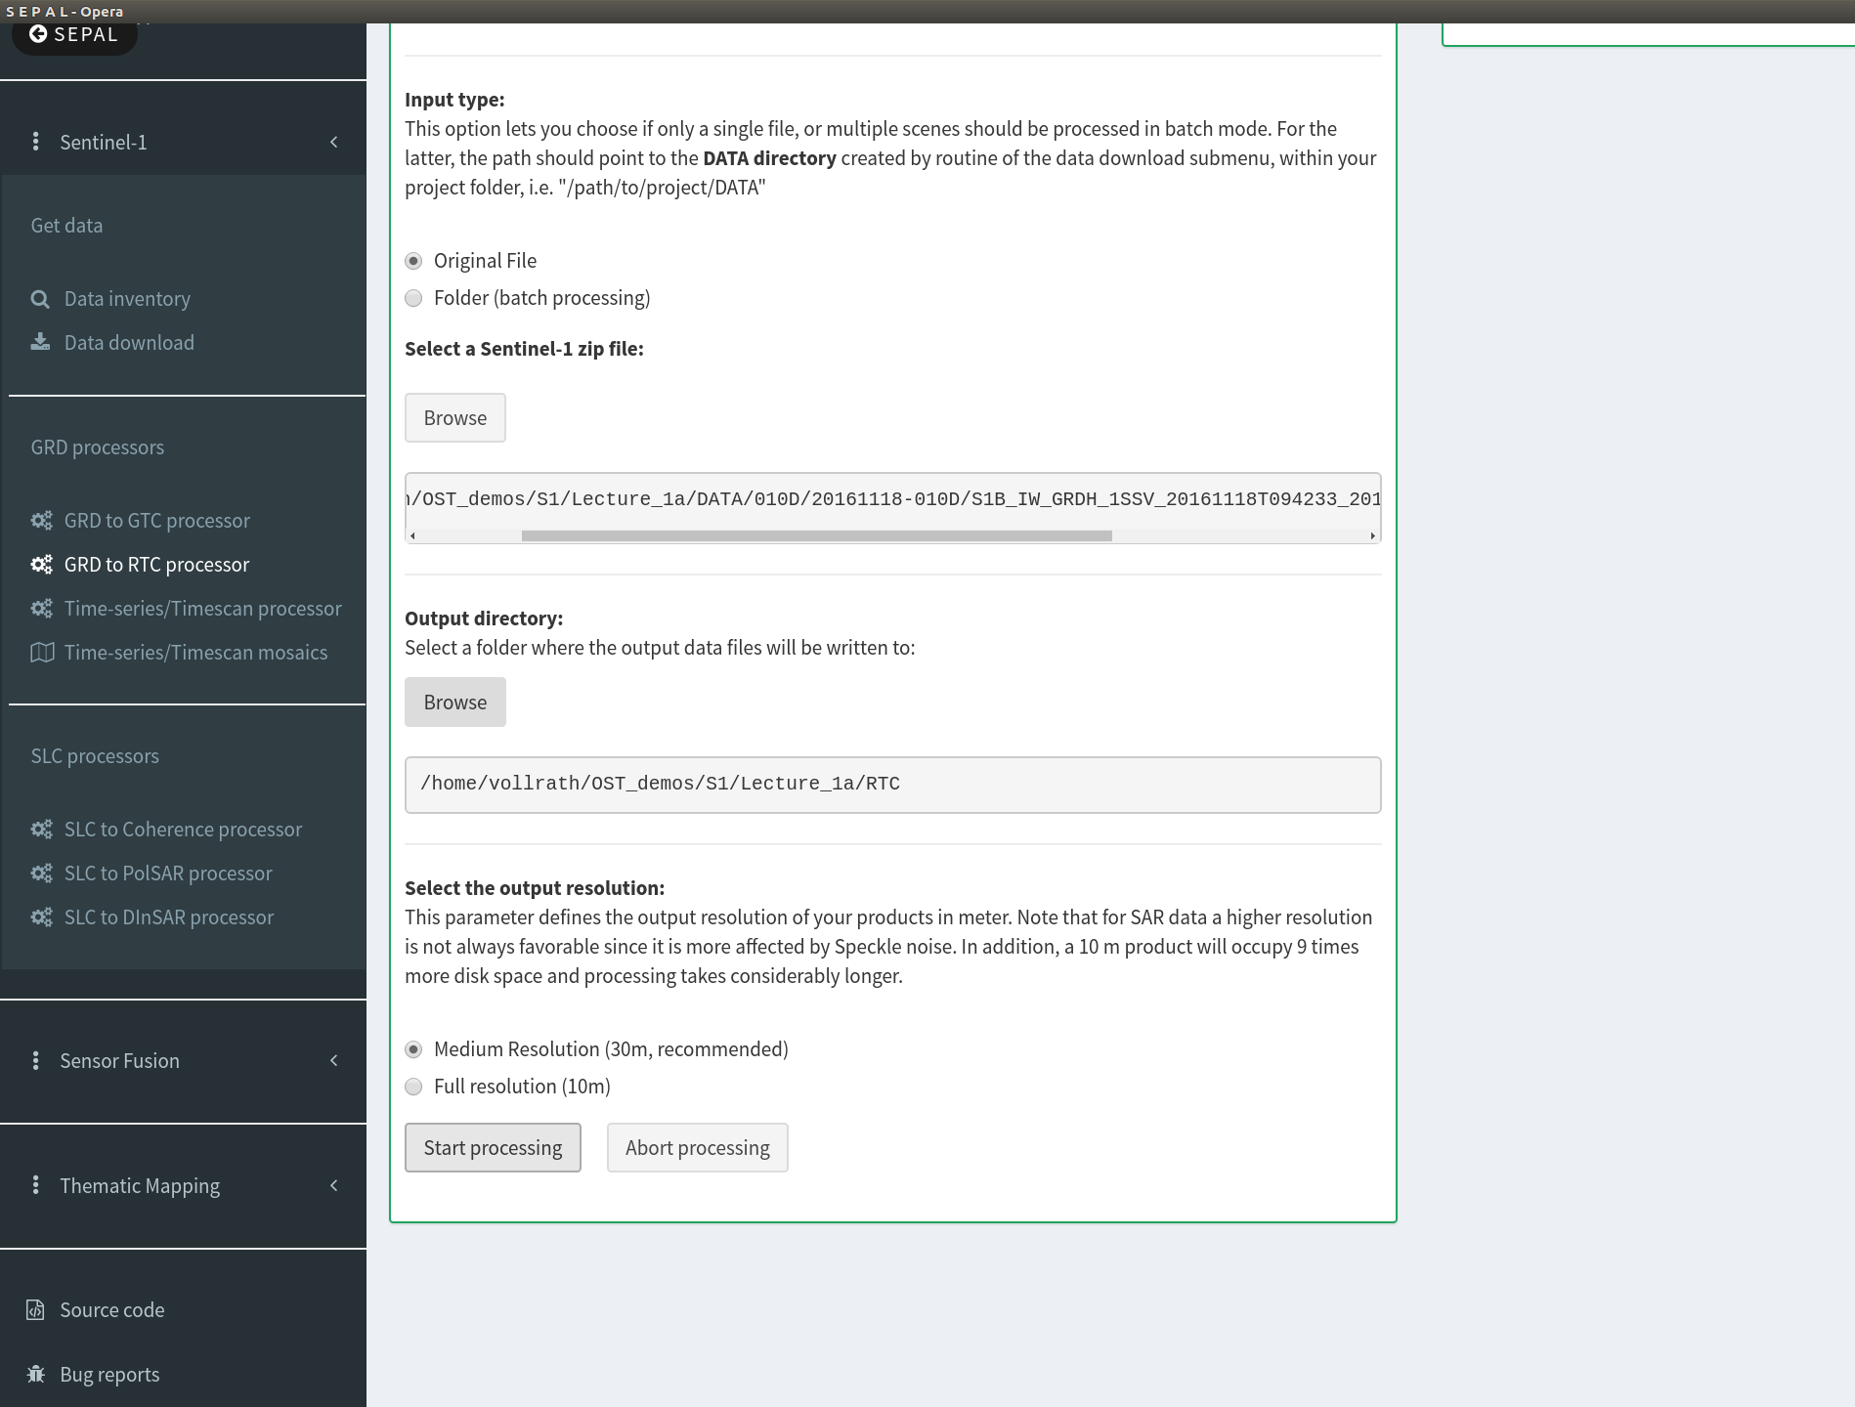
Process
1 Check if your output directory has been set correctly
2 Leave the 30m resolution as selected
3 Trigger the processing by clicking the start button
1
2
3

Slide 40
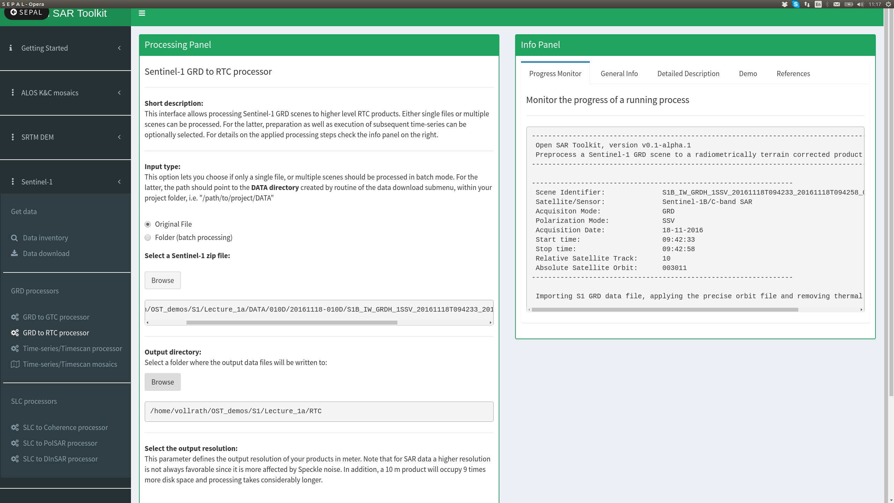
processing
Congratulations, you are just processing your first Sentinel-1 scene
Check out the other tabs in the info panel, where you can find more details on what's going on in the background

Slide 41
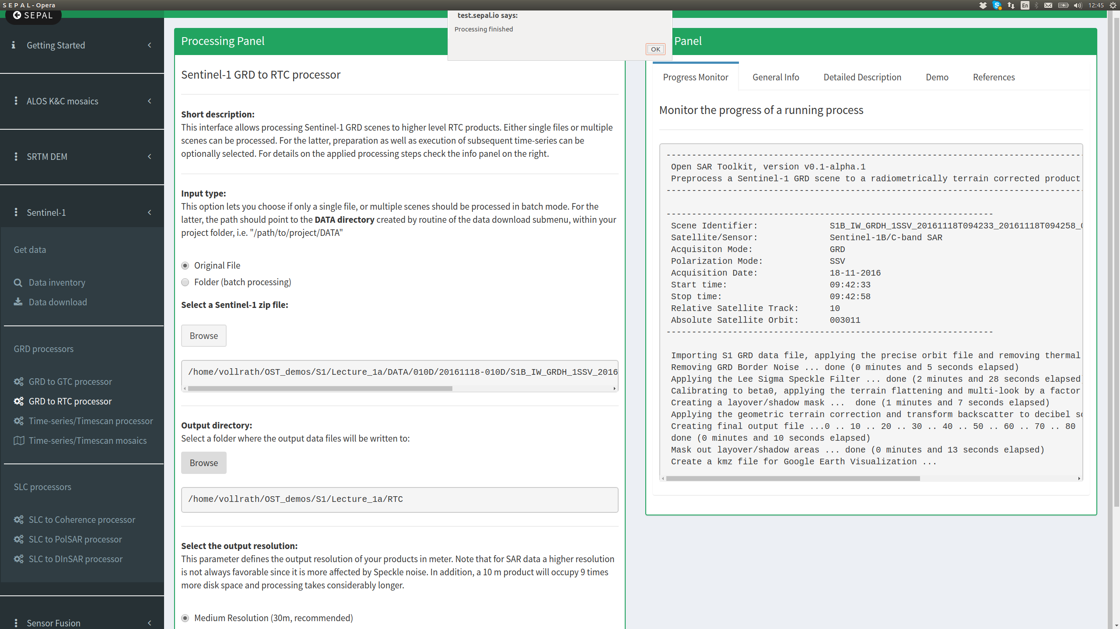
processing
2
1
1 Processing has finished when the little message window on top of the browser appears
2 In order to see the data we go back to the SEPAL main interface

Slide 42
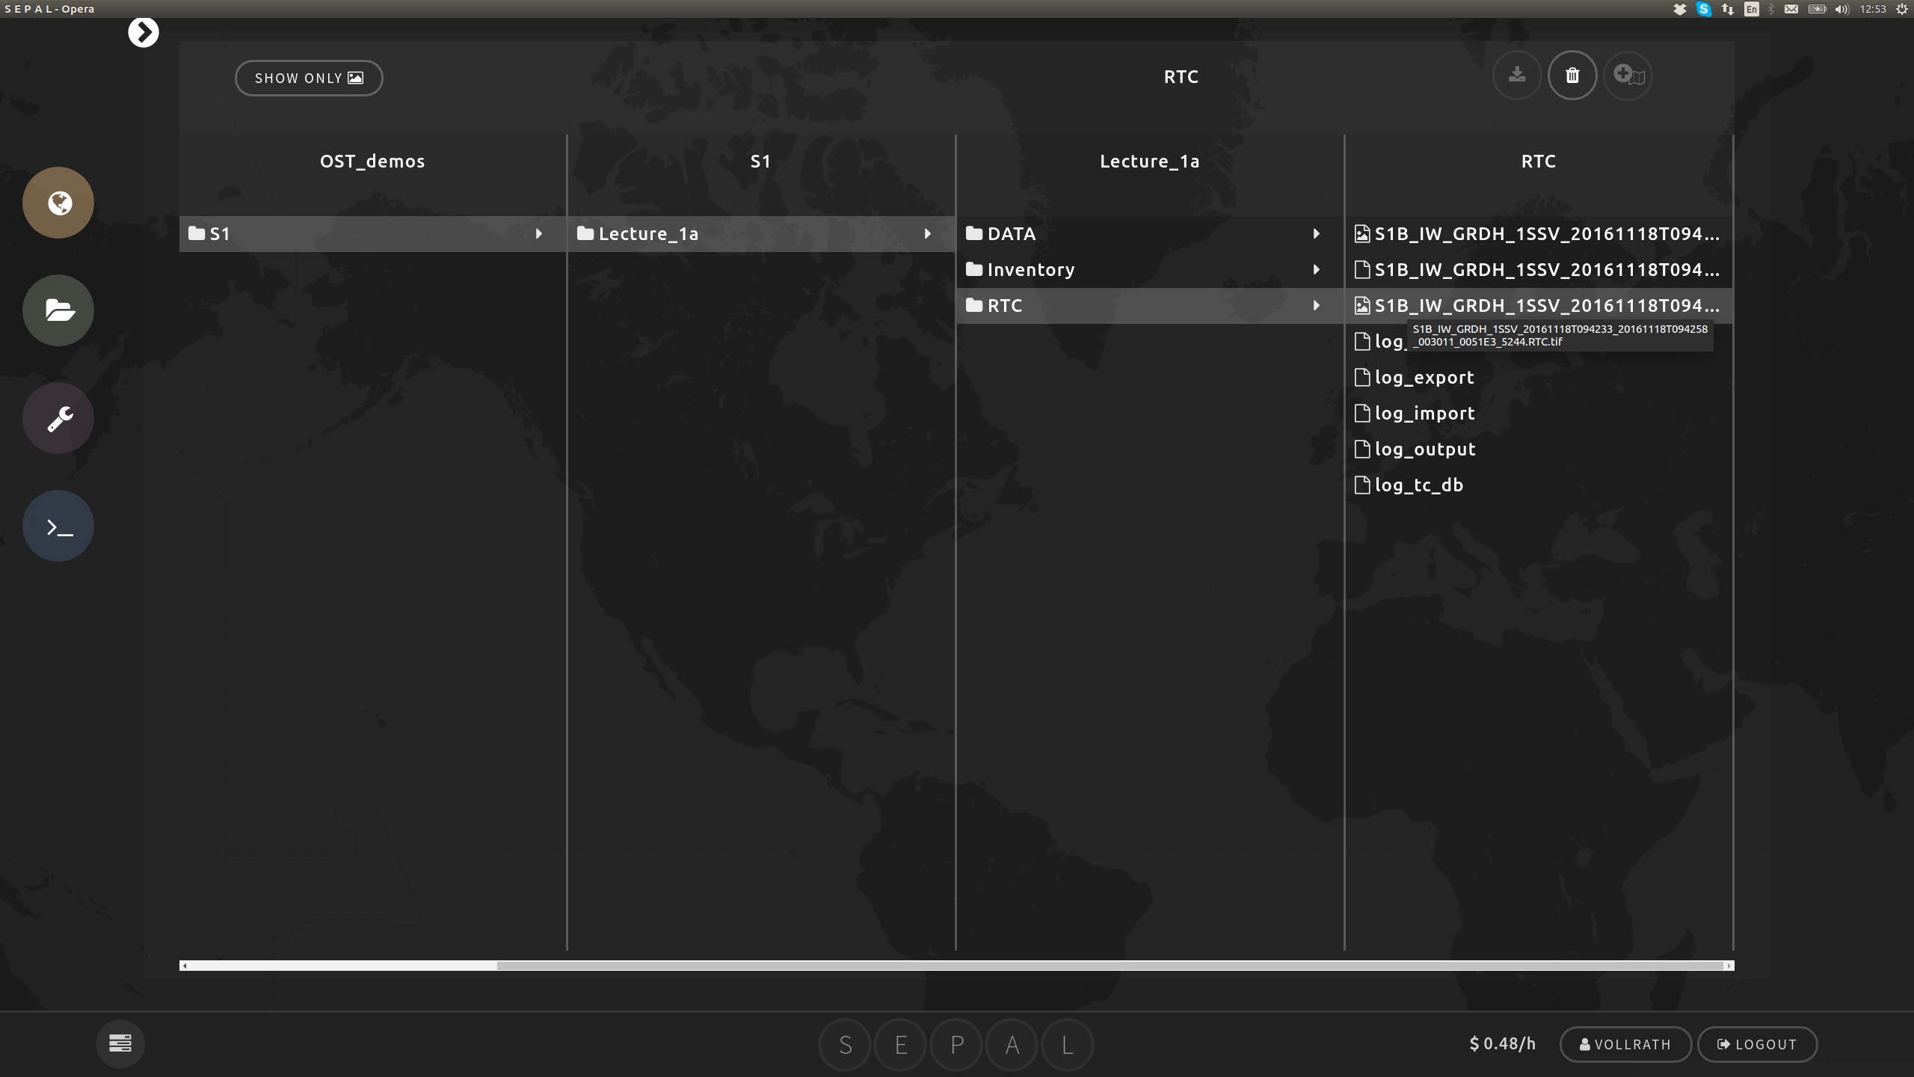
Data visualization
4
1
2
3
1 Open the browser
2 Navigate to the output directory
3 Select the file
Tip: leave the mouse pointer over the files to see the full name and choose the one ending with RTC.TIF
4 Open the Data Visualizer

Slide 43
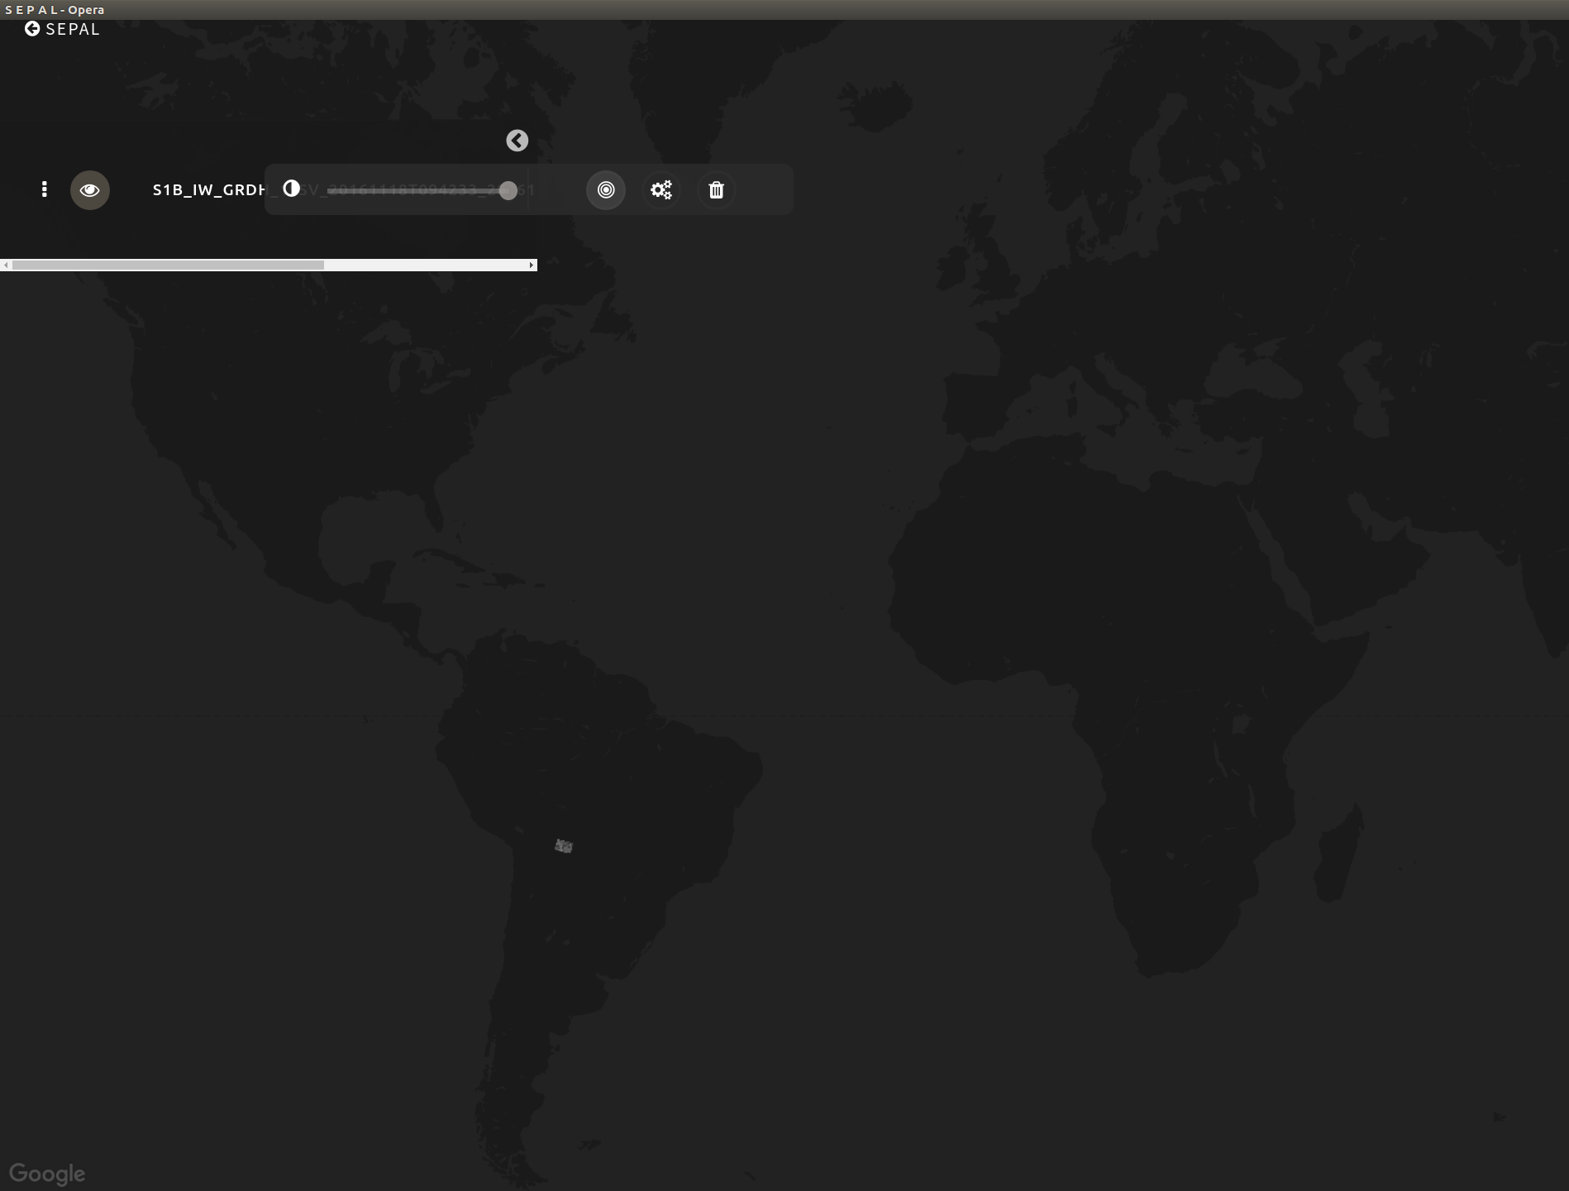
Data visualization
2
1 Scene is automatically loaded and shown on the map
2 Zoom to the layer by clicking on the target symbol
1

